Slide 1
Applied Machine Learning in Genomic and Nutritional Data Science
Tutorial @ D3 Spring School 2024
Jan Voges

Slide 2
About Us
The Genomic Data Science Group at Leibniz University Hannover

Slide 3
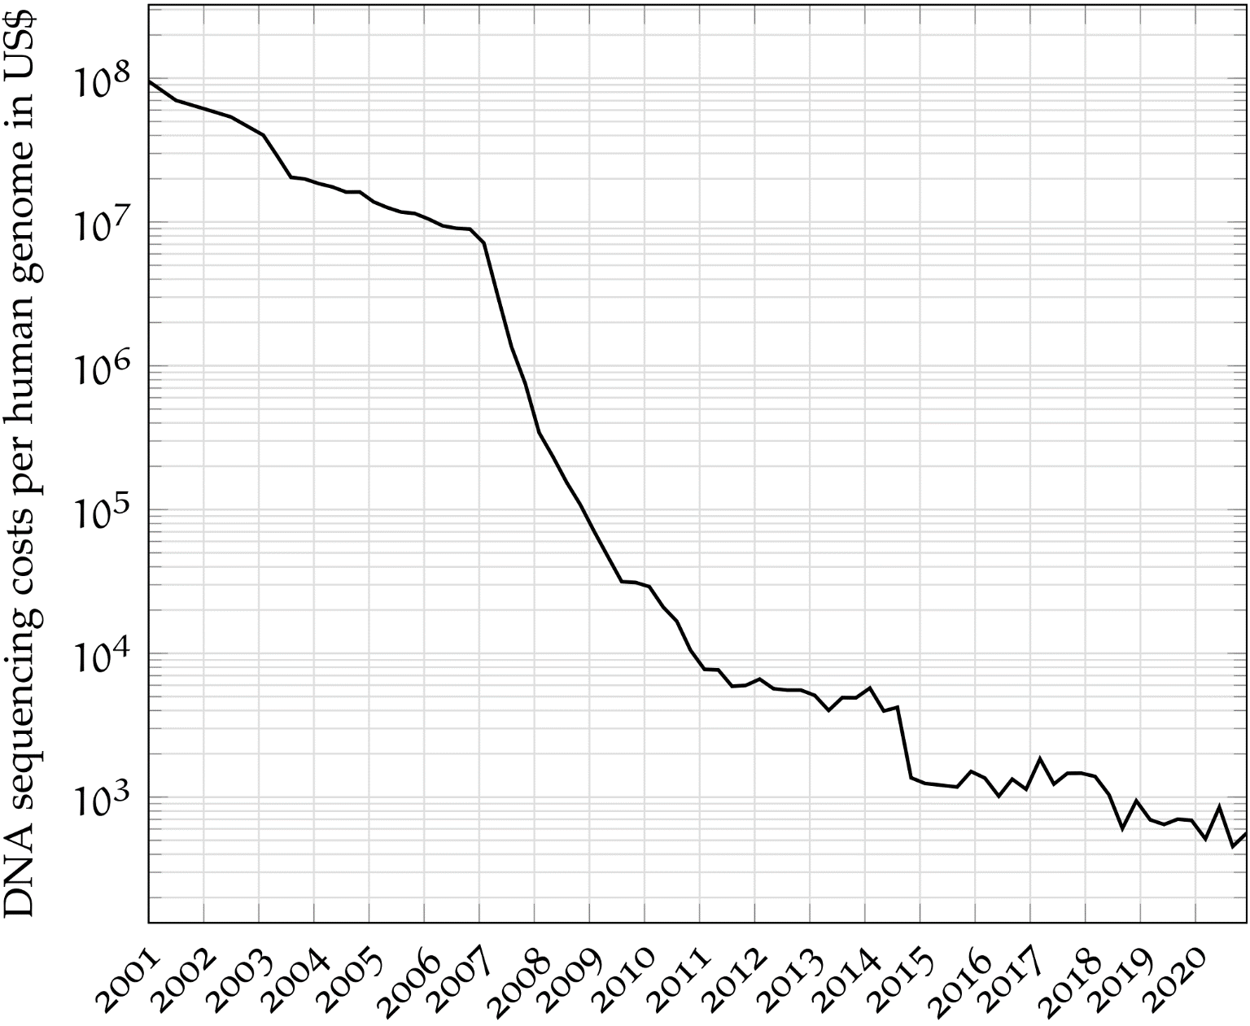
Falling DNA sequencing costs — genomics comes to life
1990–2003: US$3 billion (Human Genome Project)
2007: US$10 million (before widespread market adoption of HTS technologies)
Moore’s law
Today: < US$1,000
Notes:
Moore’s law: the costs are halved every two years

Slide 4

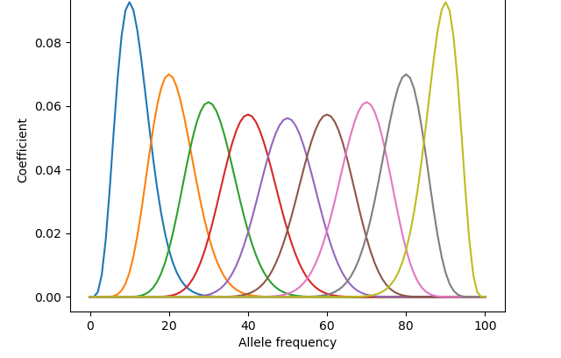

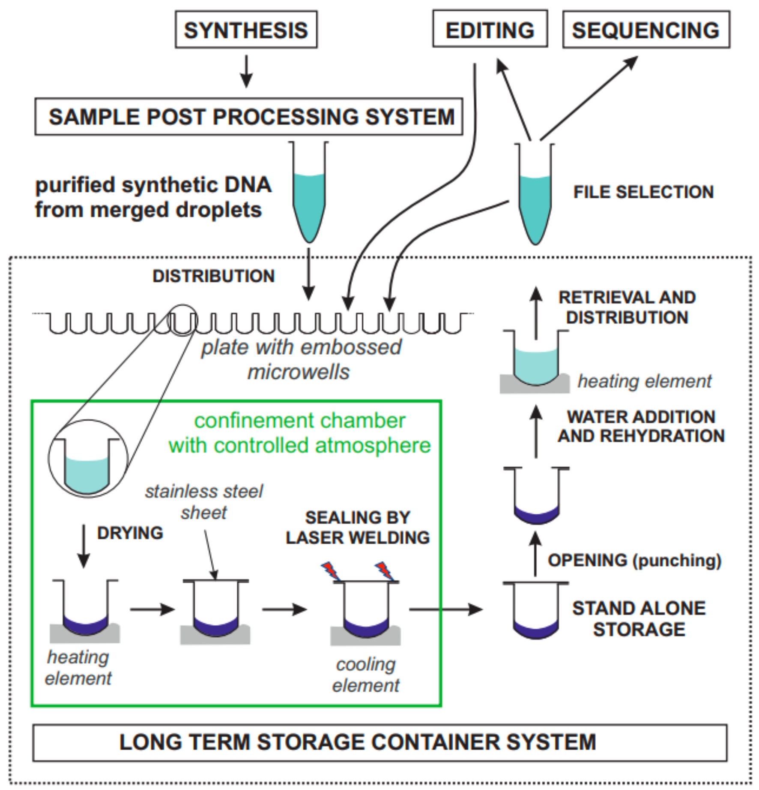
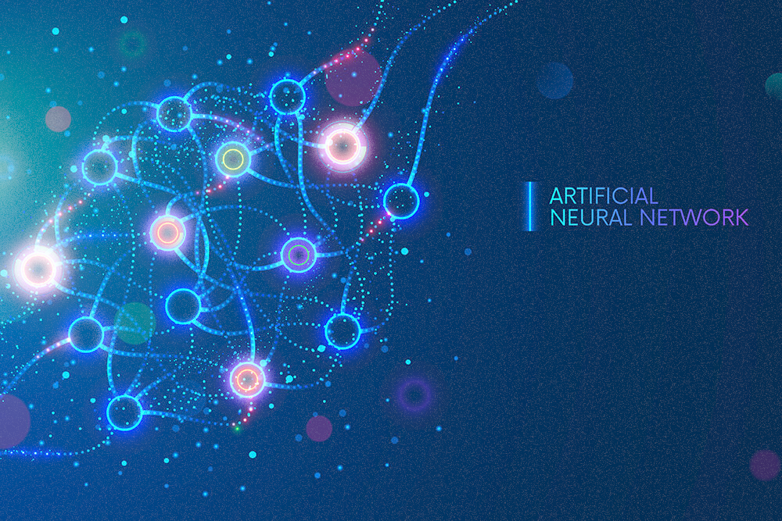

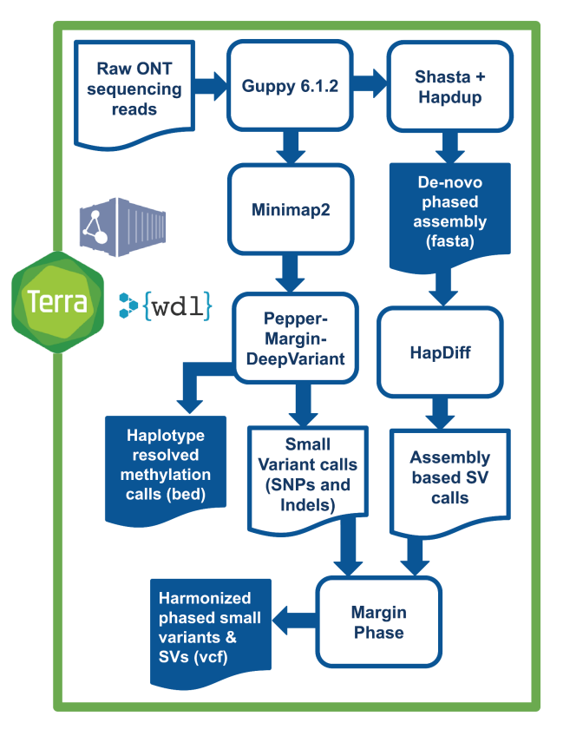
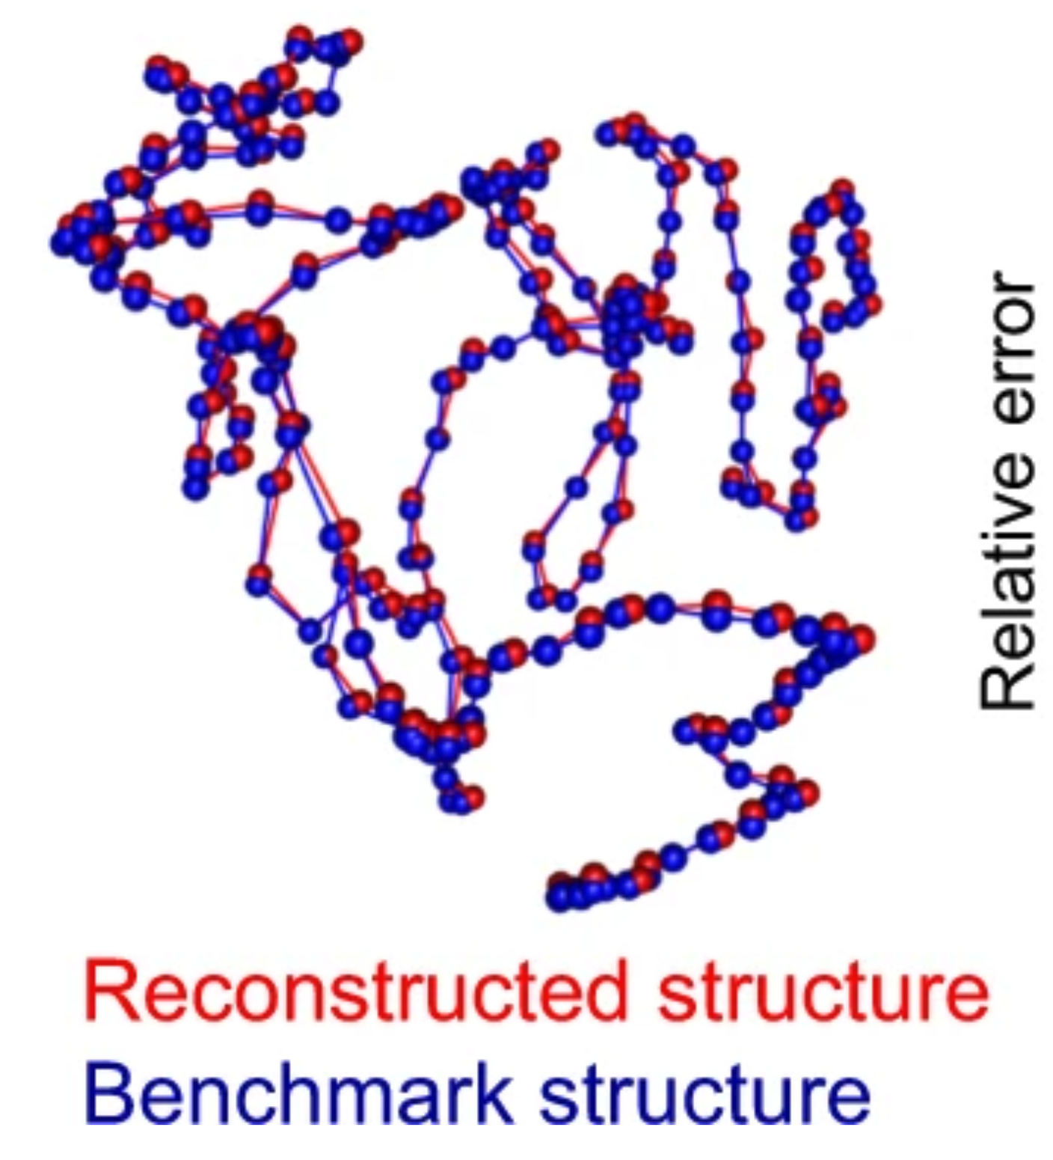
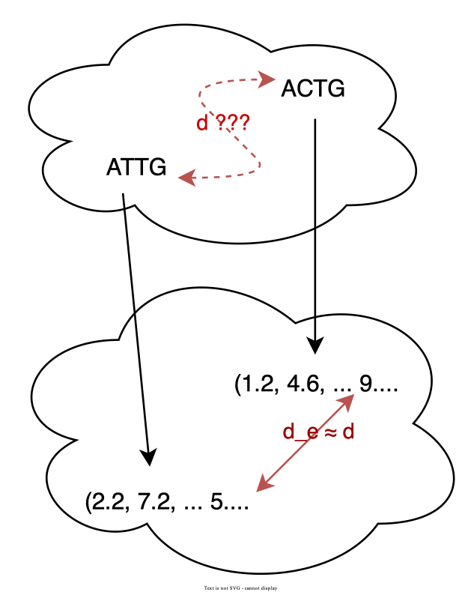
Genomic Data Science
Compression of DNA Sequencing Data
Analysis of Metagenomic DNA Sequencing Data
3D Genome Reconstruction
Edit Distance Embedding
Personalized Medicine
DNA Data Storage
Standardization
Genomic Foundation Models

Slide 5

Personalized, predictive, precise and preventive medicine
Large national study involving 1,000 patients suffering from major depressive disorder (MDD)
Bioinformatics pipeline for nanopore sequencing data
MPEG-G compression for long-read sequencing data
Data analysis infrastructure: CPU/GPU compute cluster, storage cluster with multiple petabytes

Slide 6
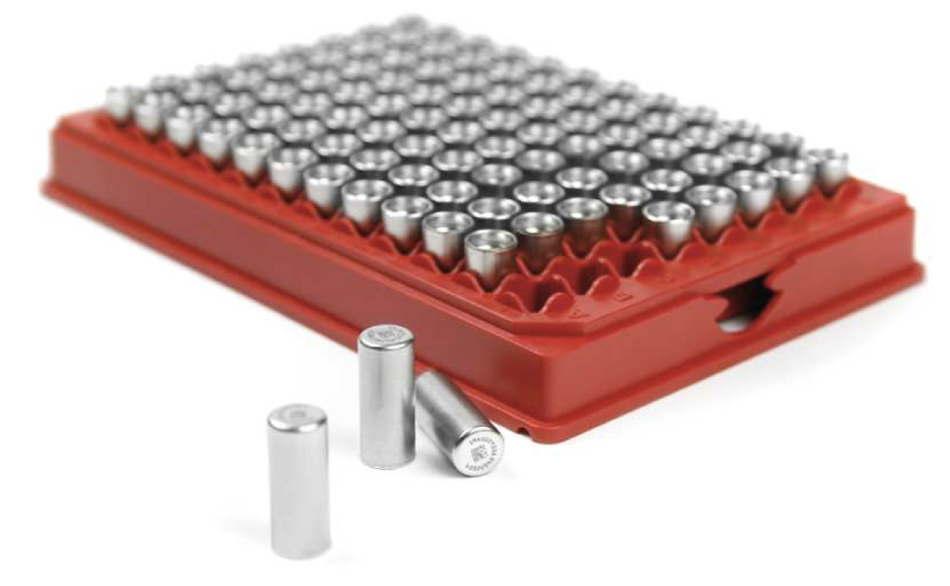

DNA — the future of long-term data storage
Researchers in fields as diverse as artificial intelligence, healthcare, astronomy and climate science seek to store massive data sets for future data mining.
Traditional data storage technologies lack longevity, density, and cost-effectiveness.
Solution: use DNA as a storage medium (density: 455 EB = 455,000,000 TB per gram)
Block-by-block DNA synthesis is the most promising approach for DNA data storage.

Slide 7
Tutorial Overview
Applied Machine Learning in Genomic and Nutritional Data Science

Slide 8
Sessions
Part 1
Part 2
Applied ML Foundations
Jan Voges
Tuesday, April 23
13:30–15:30 (2 hours)
Nutritional Science Use Case
Fabian Müntefering
Wednesday, April 24
10:15–11:45 (1.5 hours)

Slide 9
Contents
These can also be good starting points for the “Code & Beer & Chips” session…
 | Chapter | Notebook(s)
Part 1: Applied Machine Learning Foundations
 | Python Recap | python-recap
 | Machine Learning Basics | kmer-analysis
 | Unsupervised Learning | population-clustering
 | Supervised Learning | decision-tree-demo
 | Neural Network Fundamentals & Design | pytorch-tutorial gene-family-classification motif-analysis
Part 2: Nutritional Science Use Case
 | Exploring a Multimodal Nutritional Data Set | nutritional-data-learning

Slide 10



Equipment
Python + (ML) libraries + Jupyter
Google Colab — https://colab.research.google.com
Own premises — e.g., Visual Studio Code with extensions

Slide 11

Repository
https://github.com/voges/ml-nutrition-tutorial

Slide 12


Package management
https://pip.pypa.io/en/stable/getting-started/
https://conda.io/projects/conda/en/latest/user-guide/install/index.html

Slide 13

Setup time

Slide 14
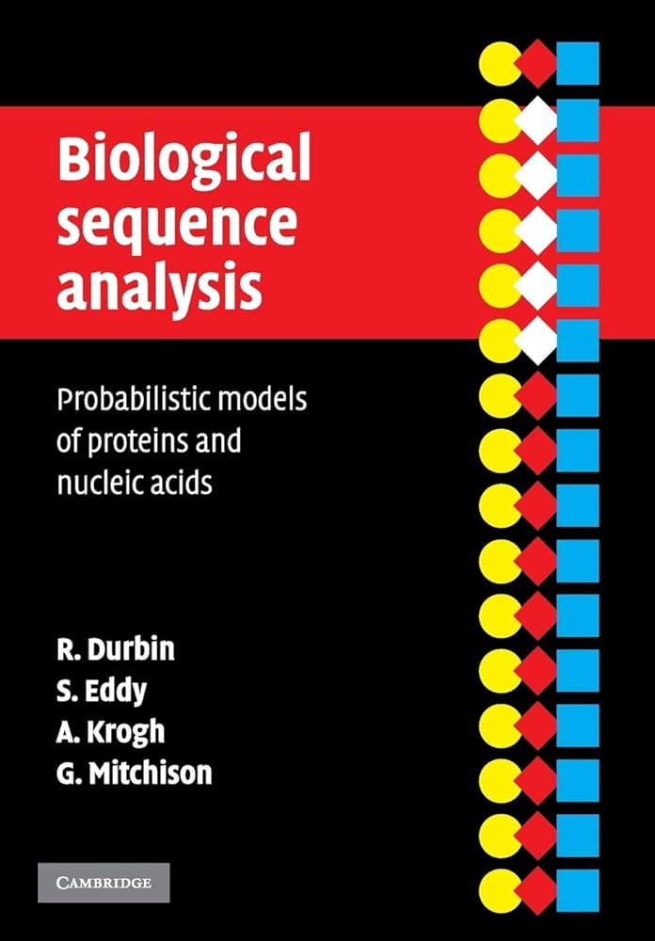

Literature
Durbin et al., Biological sequence analysis, Cambridge University Press
Goodfellow et al., Deep learning, MIT Press

Slide 15
Python Recap
Reiterating Some Python Basics

Slide 16

Python recap notebook
Notebook ‘python-recap’
Python 3’s f-strings
Plotting with matplotlib
A first glimpse into the machine learning world

Slide 17
Machine Learning Basics
Unlocking the Power of Data

Slide 18
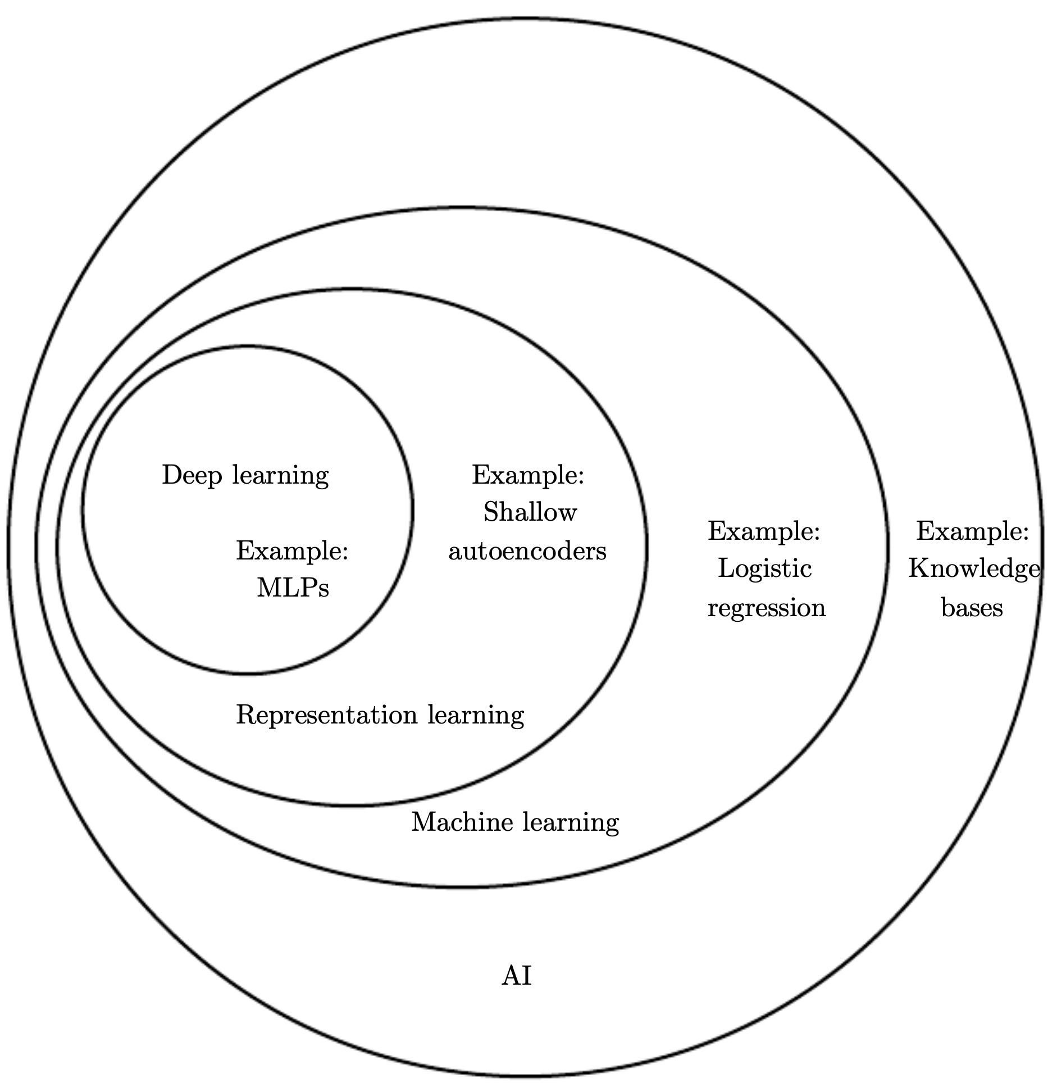
Who is who
Goodfellow et al., Deep learning

Slide 19
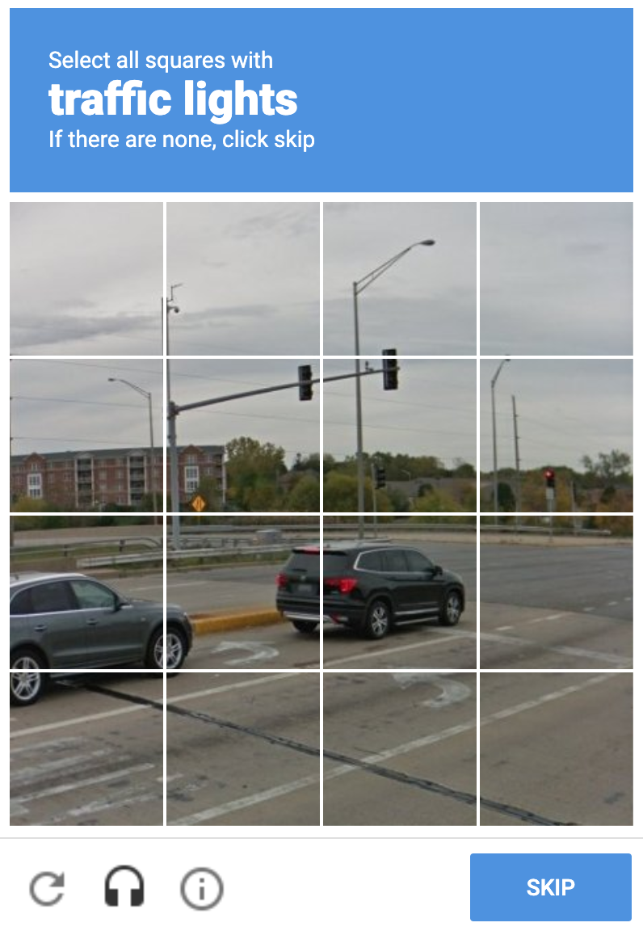
Components of ML
Data
Manual collection and curation
Automatic collection
Or somewhere in between — remember reCAPTCHA, anyone?
Features
Simple: car mileage
Obvious: word frequencies
Sophisticated/high-level: HOG, edges, …
Algorithms

Slide 20
Learning = experience + task + performance measure
Mitchell, 1997:
“A computer program is said to learn from experience E with respect to some class of tasks T and performance measure P, if its performance at tasks in T, as measured by P, improves with experience E. “

Slide 21
Experience
Datasets… here are some prominent computer vision datasets:
ImageNet | Labeled object image database, used in the ImageNet Large Scale Visual Recognition Challenge | Labeled objects, bounding boxes, descriptive words, SIFT features
Caltech 101 | Pictures of objects. | Detailed object outlines marked.
CIFAR-10 | Many small, low-resolution, images of 10 classes of objects. | Classes labeled; training set splits created.
MNIST database | Database of handwritten digits. | Hand-labeled.

Slide 22
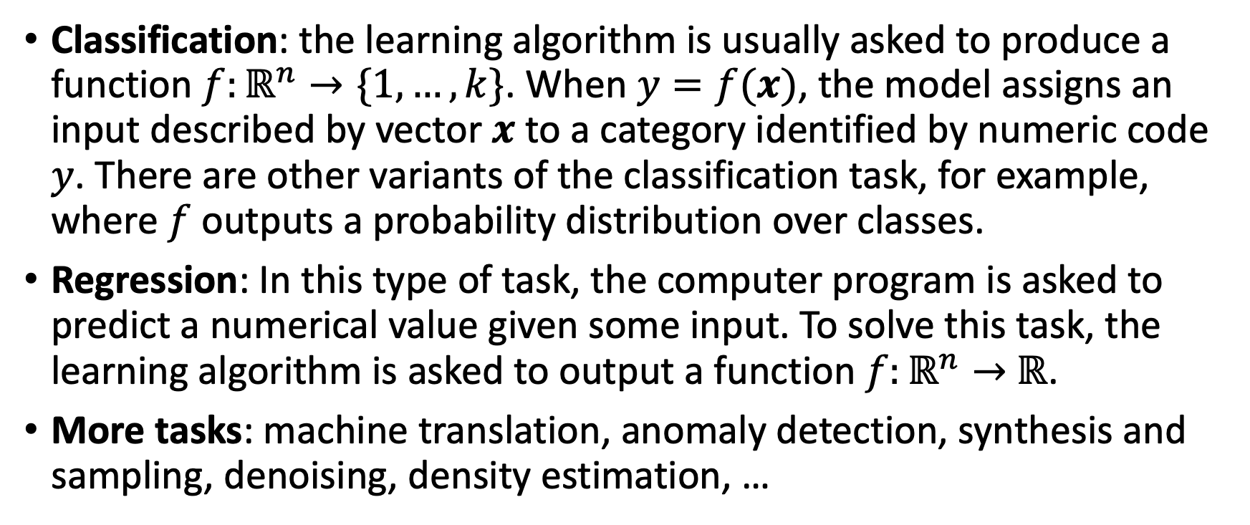
Tasks
Classification: the learning algorithm is usually asked to produce a function $f:ℝ^{n}→\{1,…,k\}$. When $y=f(x)$, the model assigns an input described by vector $x$ to a category identified by numeric code $y$. There are other variants of the classification task, for example, where $f$ outputs a probability distribution over classes.
Regression: In this type of task, the computer program is asked to predict a numerical value given some input. To solve this task, the learning algorithm is asked to output a function $f:ℝ^{n}→$ $ℝ$.
More tasks: machine translation, anomaly detection, synthesis and sampling, denoising, density estimation, …

Slide 23
Performance measures
Metrics:
Mean absolute error (MAE)
Mean squared error (MSE)
Accuracy
Precision & recall
F1-score
AUROC
…

Slide 24
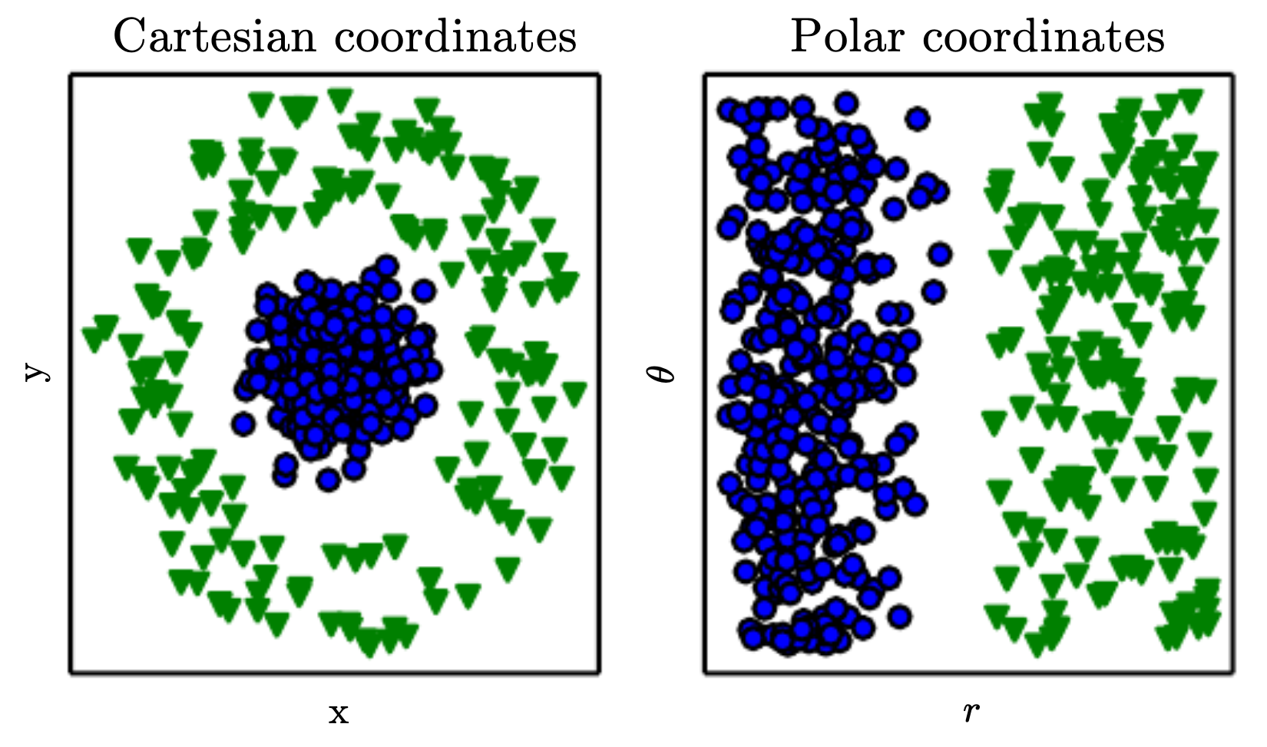
Feature representation is key
Many AI tasks can be solved by designing the right set of features to extract for that task, then providing these feature to a simple ML algorithm.
Goodfellow et al., Deep learning

Slide 25

Supervised and unsupervised learning
vas3k, 2023

Slide 26
Unsupervised Learning
Discovering Patterns Beyond Labels

Slide 27
Unsupervised learning examples
Unsupervised learning
↳ Clustering
↳ k-means
Unsupervised learning
↳ Dimensionality reduction
↳ PCA

Slide 28

A very high-level view on clustering
Goal: structure articles by topic, i.e., discover groups (clusters) of related articles

Slide 29
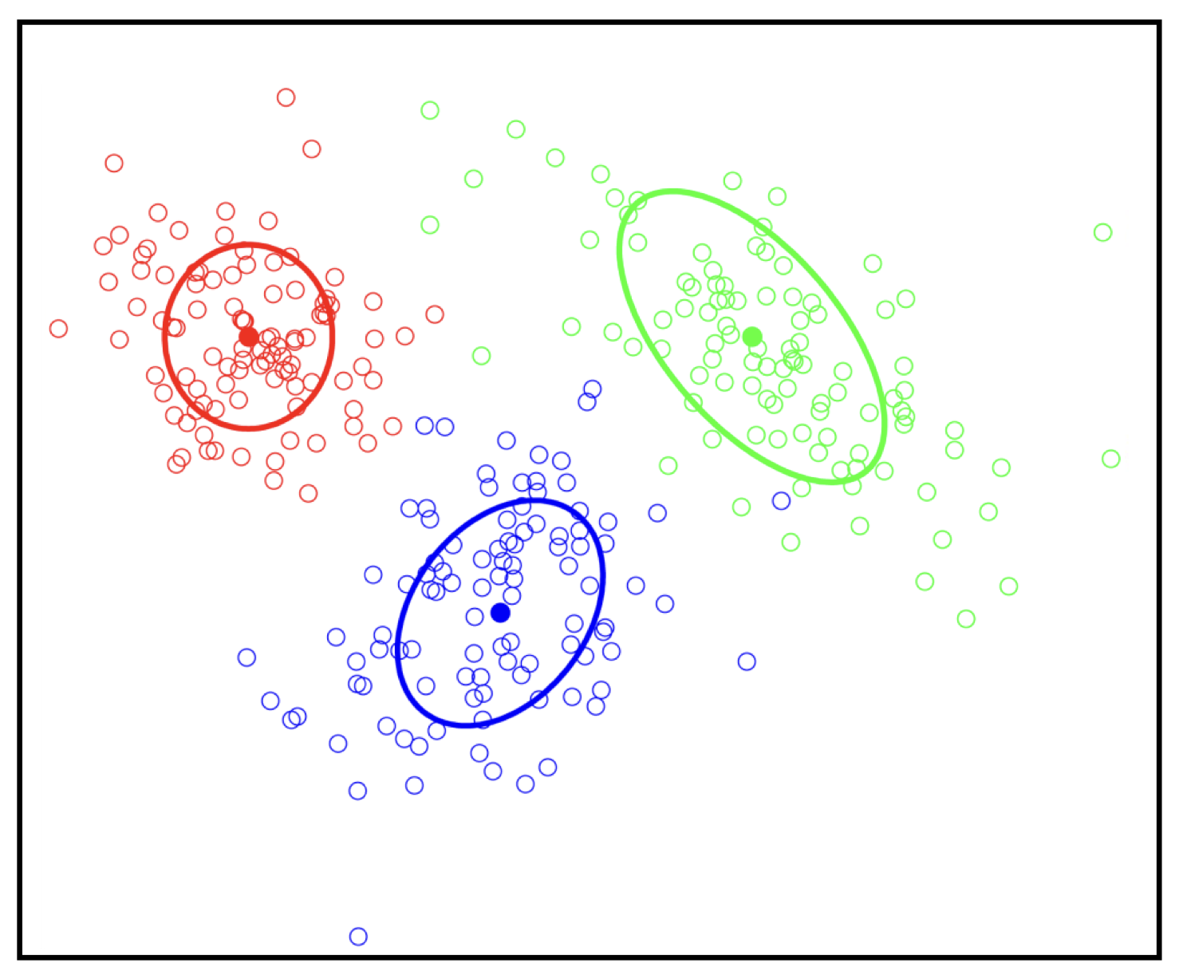
Clustering — an unsupervised learning task
No labels provided … uncover cluster structure from input alone!

Slide 30
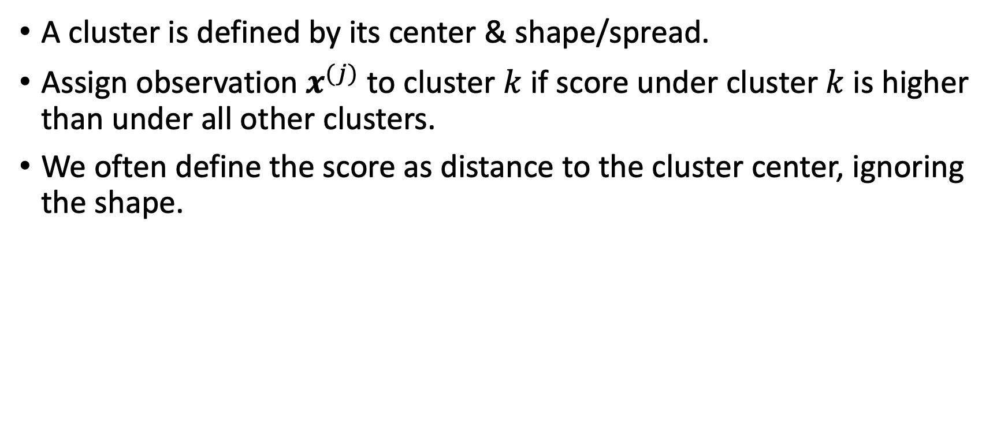
What defines a cluster?
A cluster is defined by its center & shape/spread.
Assign observation $x^{(j)}$ to cluster $k$ if score under cluster $k$ is higher than under all other clusters.
We often define the score as distance to the cluster center, ignoring the shape.

Slide 31
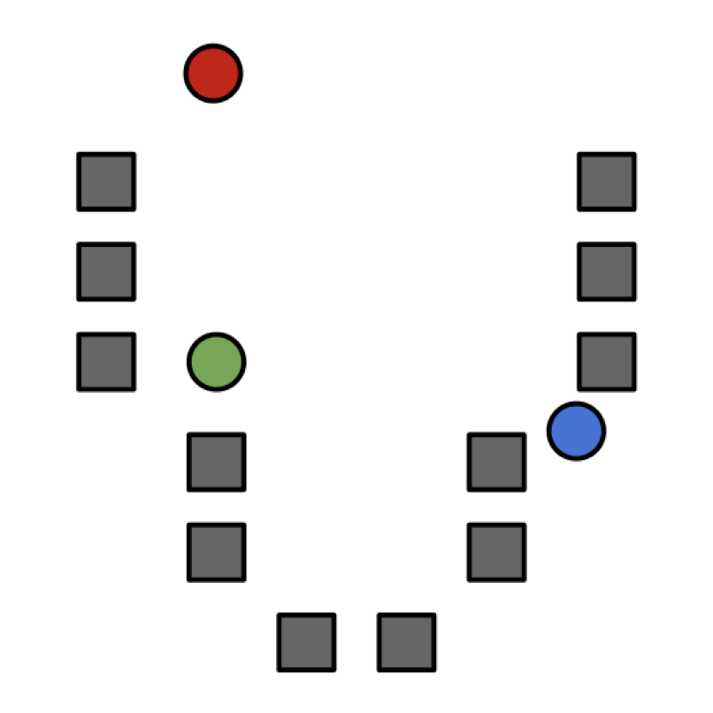
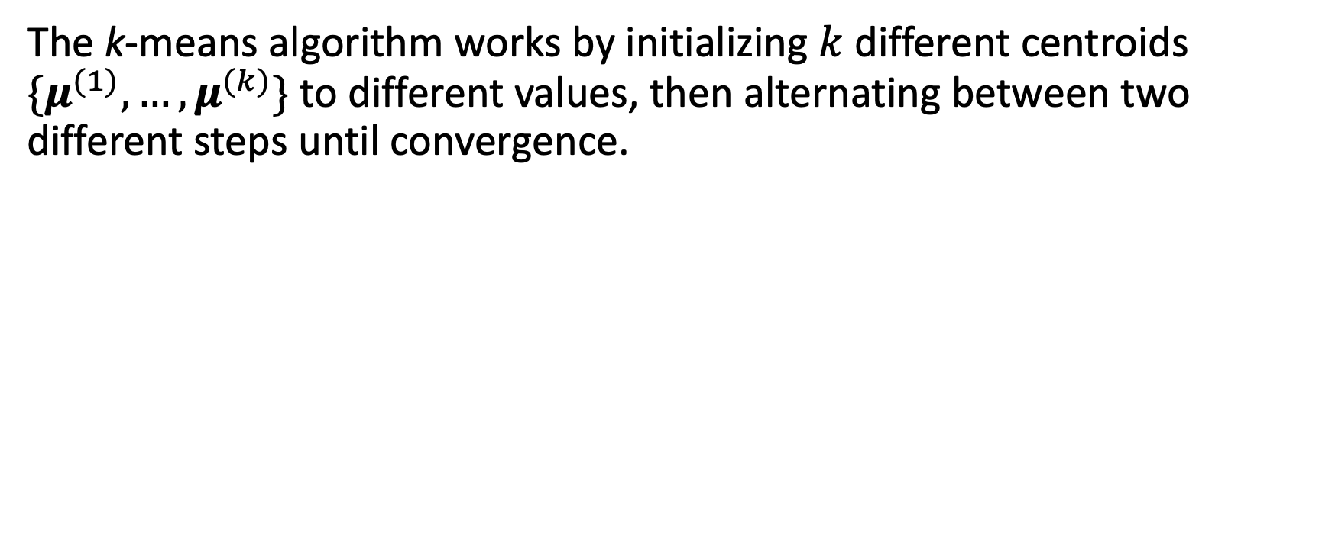
k-means
The k-means algorithm works by initializing $k$ different centroids $\{μ^{(1)},…,μ^{(k)}\}$ to different values, then alternating between two different steps until convergence.

Slide 32
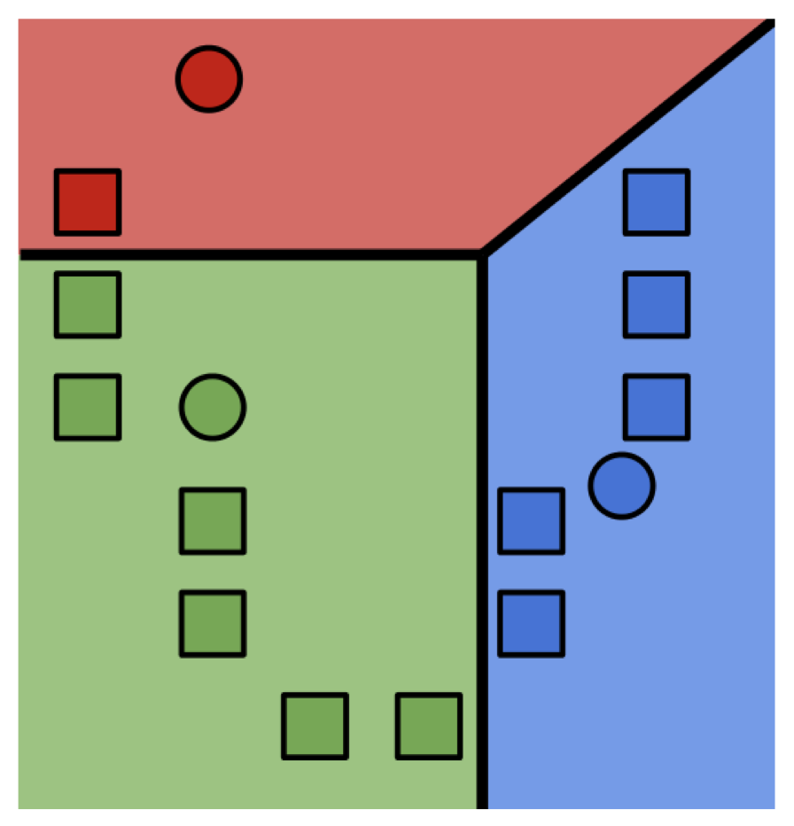
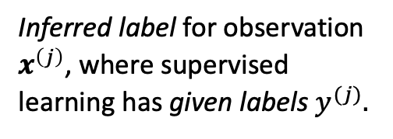
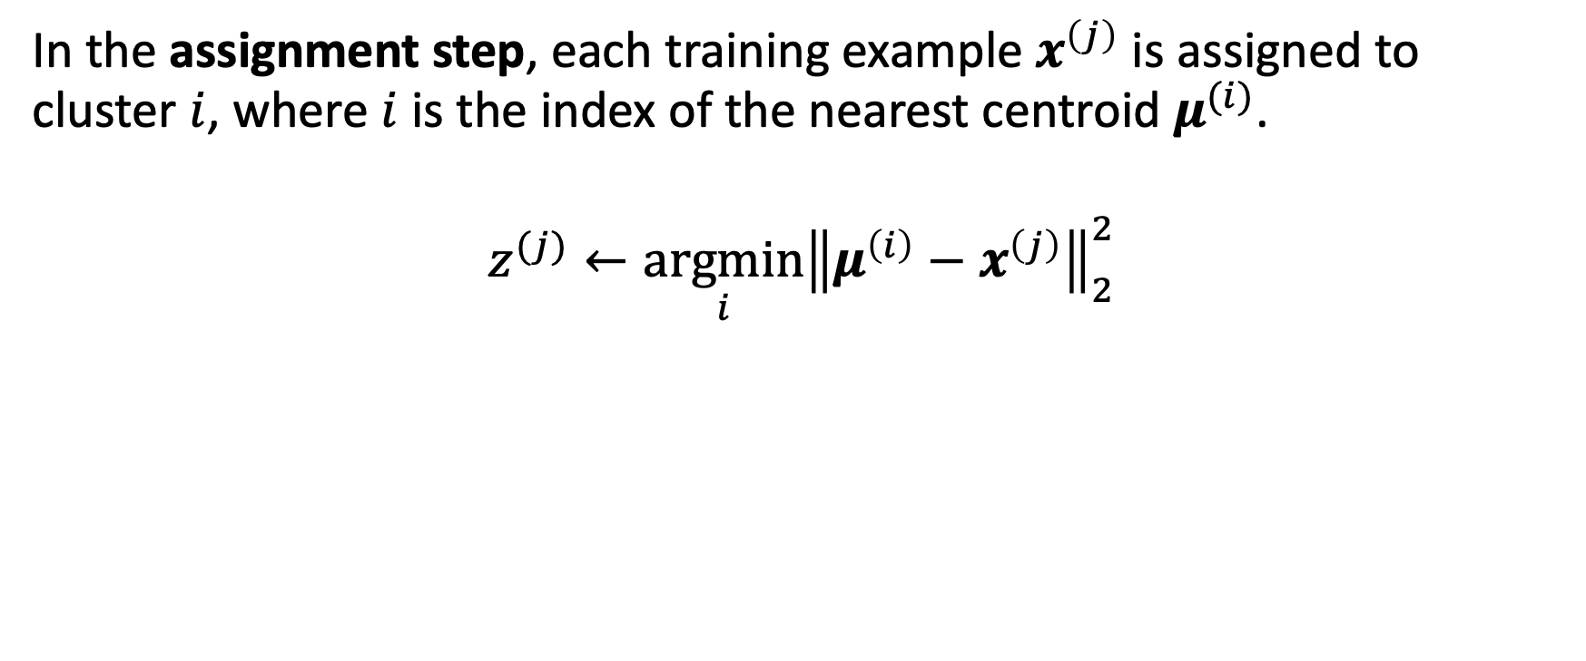
k-means
In the assignment step, each training example $x^{\left(j\right)}$ is assigned to cluster $i$, where $i$ is the index of the nearest centroid $μ^{(i)}$.
$$z^{(j)}←\underset{i}{argmin}{{\left\|μ^{\left(i\right)}−x^{\left(j\right)}\right\|}_{2}^{2}}$$
Inferred label for observation $x^{\left(j\right)}$, where supervised learning has given labels $y^{(j)}.$

Slide 33
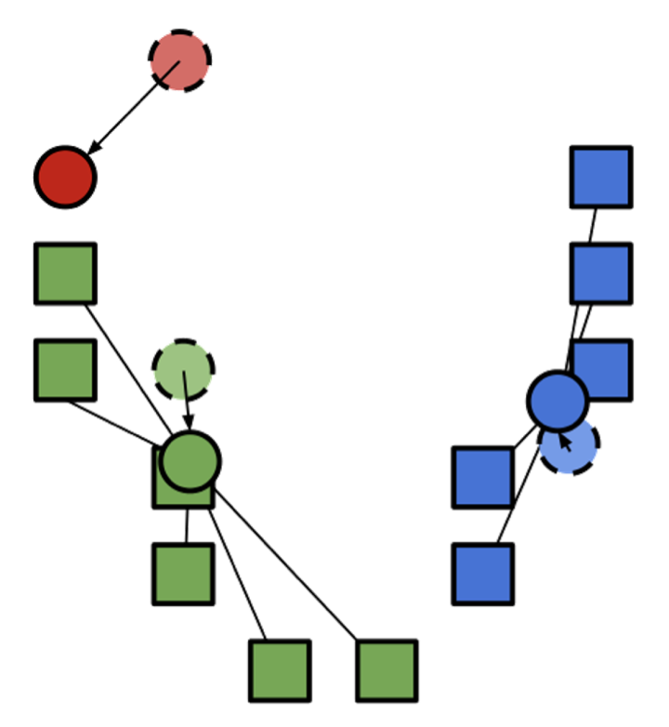
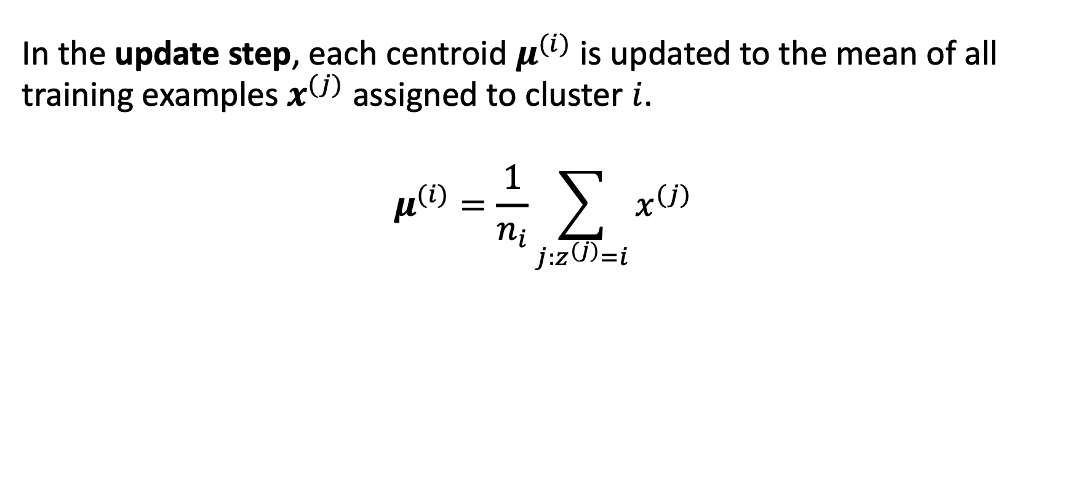
k-means
In the update step, each centroid $μ^{(i)}$is updated to the mean of all training examples $x^{(j)}$ assigned to cluster $i$.
$$μ^{(i)}=\frac{1}{n_{i}}\sum_{j:z^{(j)}=i}{x^{(j)}}$$

Slide 34
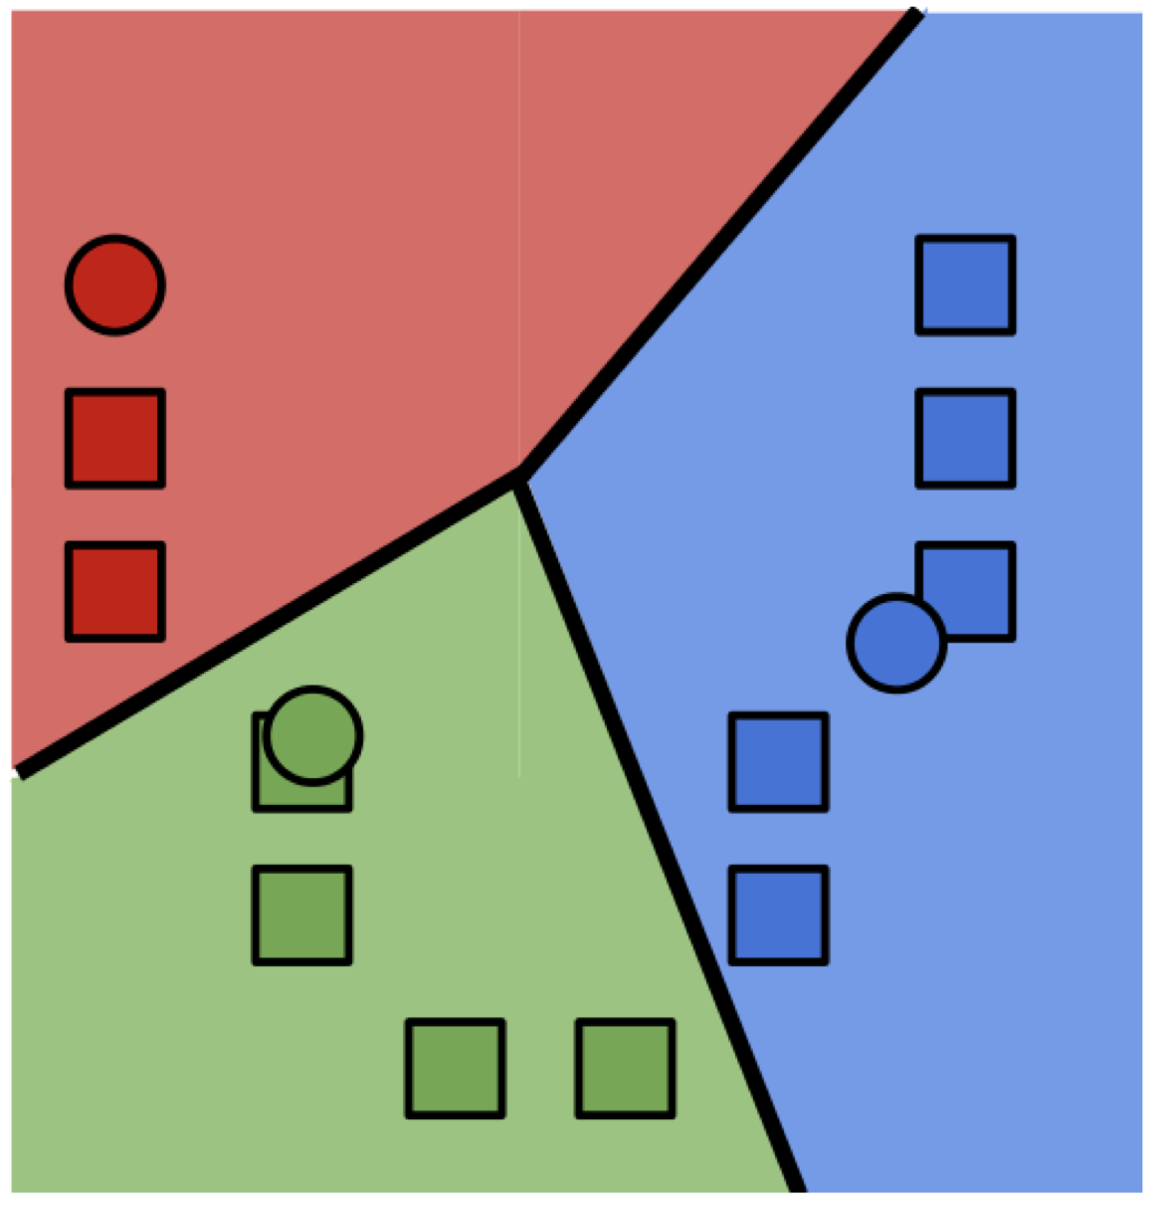
k-means
Initialize cluster centers
Assignment step
Update step
Iterate 1.+2. until convergence

Slide 35
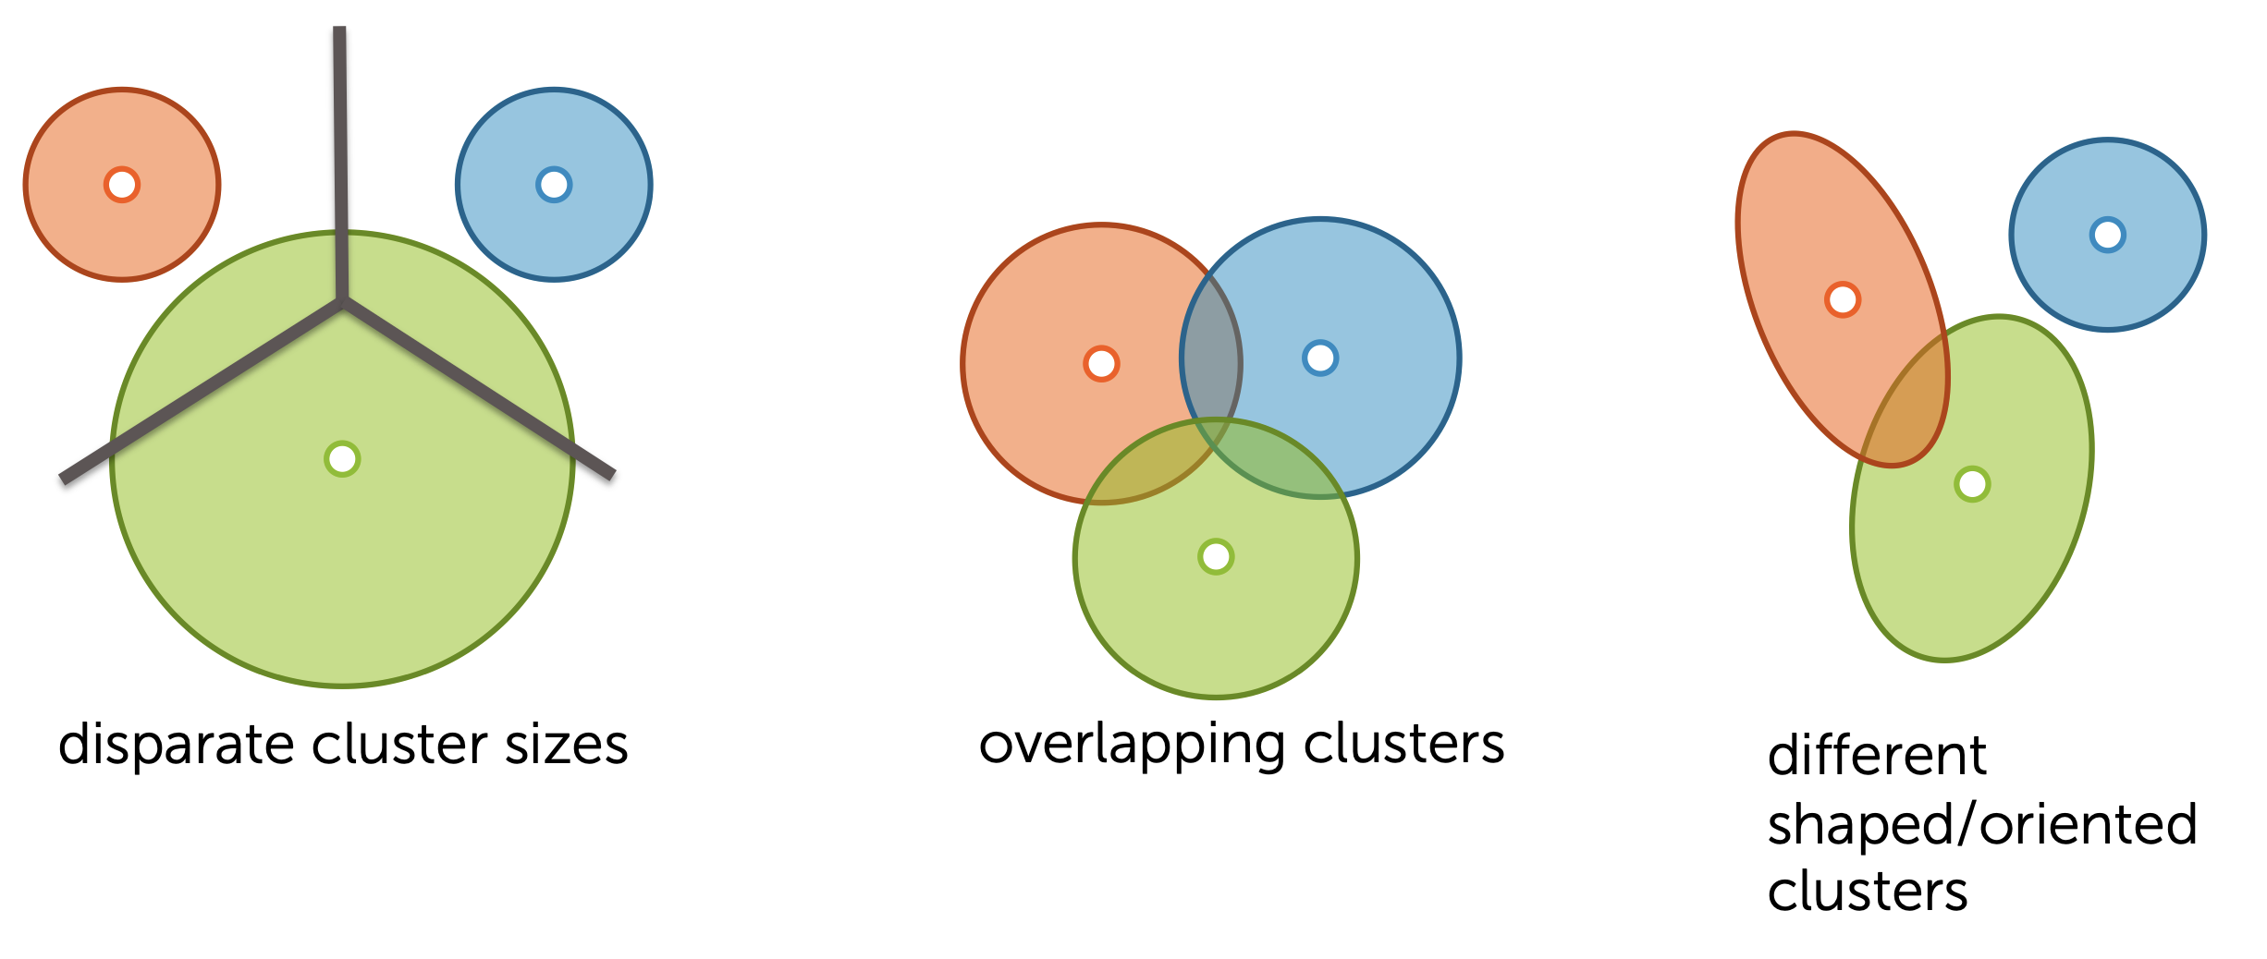
Failure modes of k-means

Slide 36
Unsupervised learning examples
Unsupervised learning
↳ Clustering
↳ k-means
Unsupervised learning
↳ Dimensionality reduction
↳ PCA

Slide 37
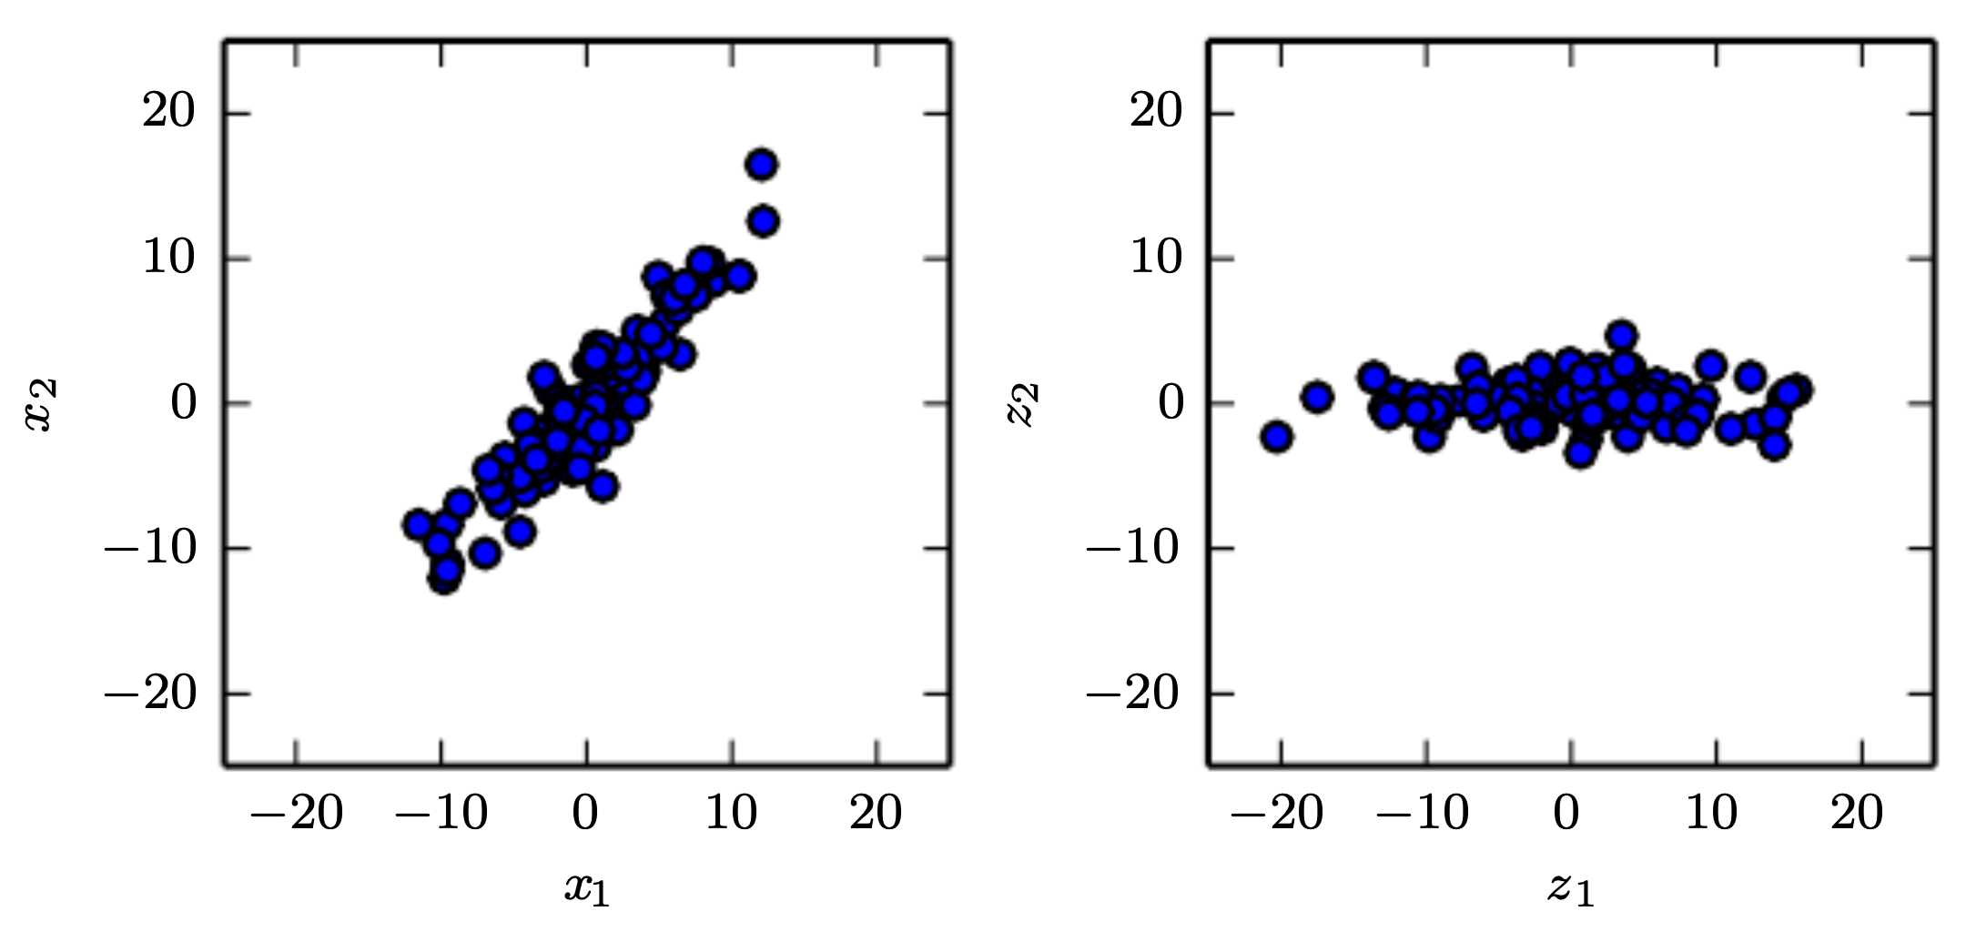
Principal component analysis (PCA)
Goodfellow et al., Deep learning
Notes:
PCA learns a linear projection that aligns the direction of greatest variance with the axes of the new space.

Slide 38
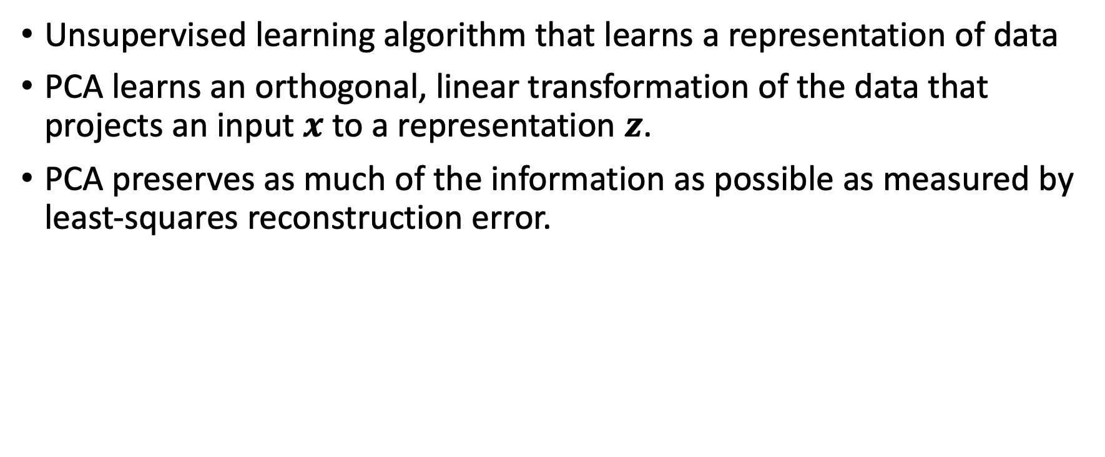
PCA
Unsupervised learning algorithm that learns a representation of data
PCA learns an orthogonal, linear transformation of the data that projects an input $x$ to a representation $z$.
PCA preserves as much of the information as possible as measured by least-squares reconstruction error.

Slide 39
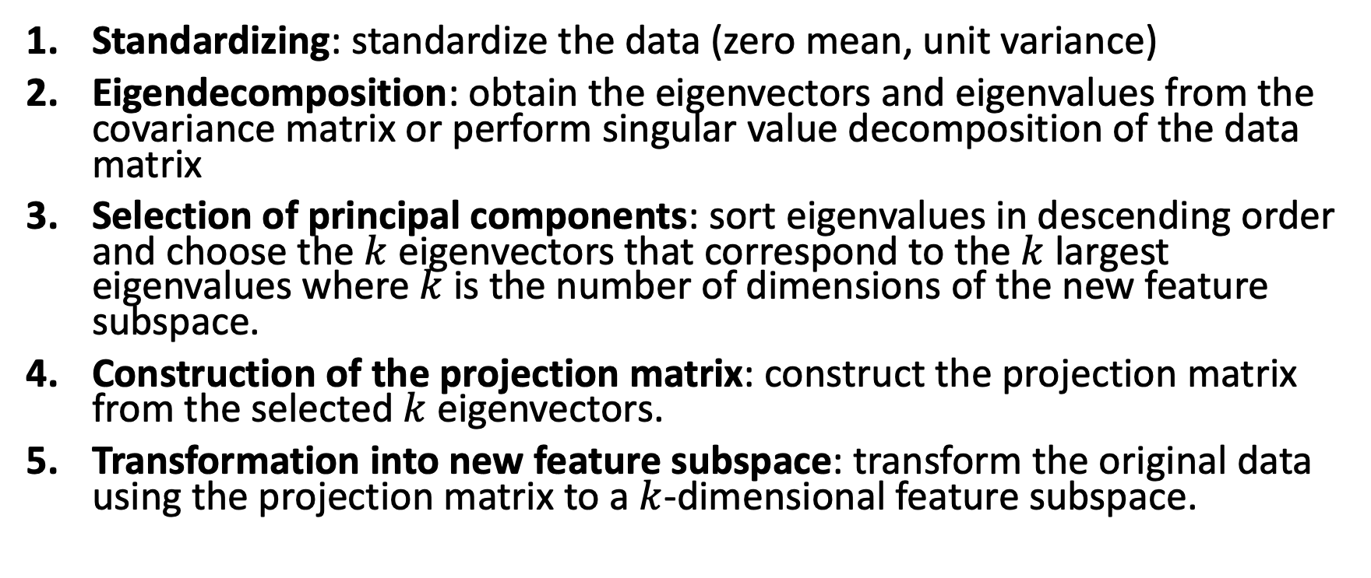
PCA step by step
Standardizing: standardize the data (zero mean, unit variance)
Eigendecomposition: obtain the eigenvectors and eigenvalues from the covariance matrix or perform singular value decomposition of the data matrix
Selection of principal components: sort eigenvalues in descending order and choose the $k$ eigenvectors that correspond to the $k$largest eigenvalues where $k$is the number of dimensions of the new feature subspace.
Construction of the projection matrix: construct the projection matrix from the selected $k$eigenvectors.
Transformation into new feature subspace: transform the original data using the projection matrix to a $k$-dimensional feature subspace.

Slide 40
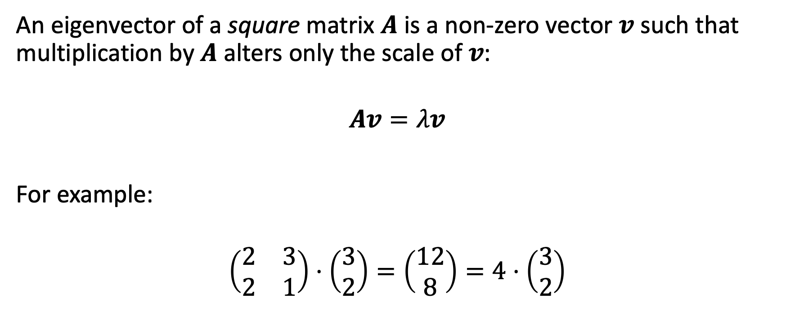
Eigendecomposition
An eigenvector of a square matrix $A$ is a non-zero vector $v$ such that multiplication by $A$ alters only the scale of $v$:
$$Av=λv$$
For example:
$$\left(\begin{matrix}2 & 3 \\ 2 & 1\end{matrix}\right)⋅\left(\begin{matrix}3 \\ 2\end{matrix}\right)=\left(\begin{matrix}12 \\ 8\end{matrix}\right)=4⋅\left(\begin{matrix}3 \\ 2\end{matrix}\right)$$

Slide 41
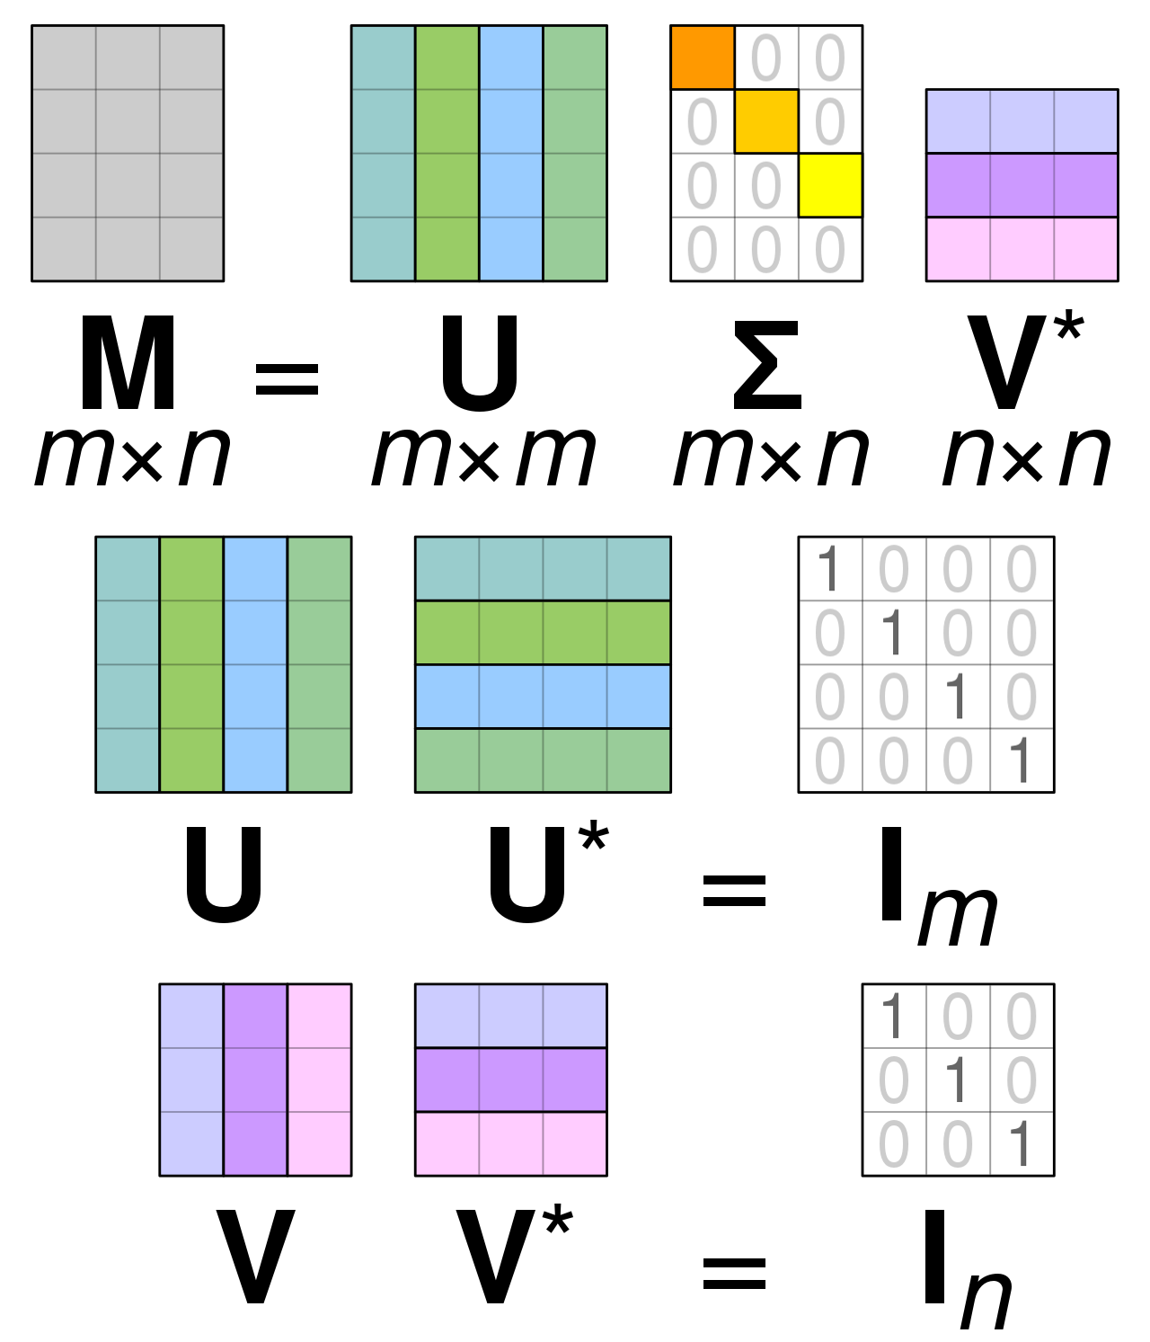
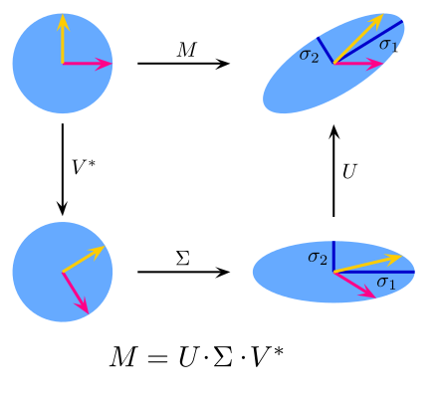
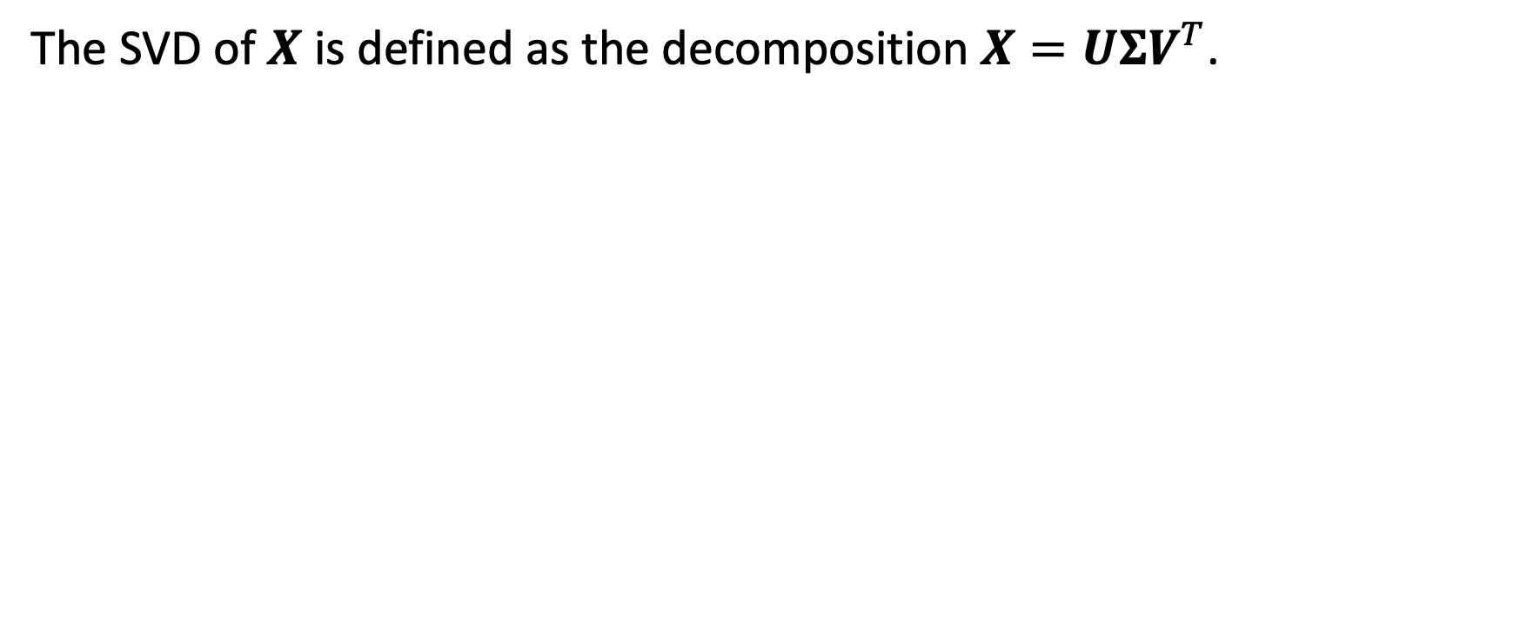
Singular value decomposition (SVD)
The SVD of $X$ is defined as the decomposition $X=UΣV^{T}$.

Slide 42
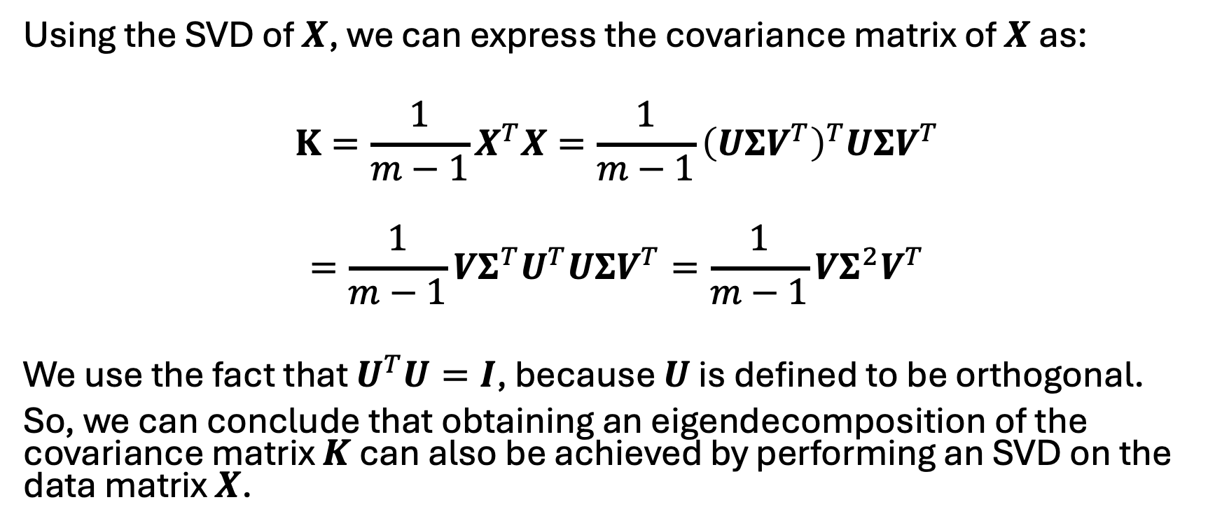
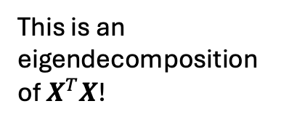
Eigendecomposition vs. SVD
Using the SVD of $X$, we can express the covariance matrix of $X$ as:
$$K=\frac{1}{m−1}X^{T}X=\frac{1}{m−1}{\left(UΣV^{T}\right)}^{T}UΣV^{T}$$
$$=\frac{1}{m−1}VΣ^{T}U^{T}UΣV^{T}=\frac{1}{m−1}VΣ^{2}V^{T}$$
We use the fact that $U^{T}U=I$, because $U$ is defined to be orthogonal.
So, we can conclude that obtaining an eigendecomposition of the covariance matrix $K$ can also be achieved by performing an SVD on the data matrix $X$.
This is an eigendecomposition of $X^{T}X$!

Slide 43
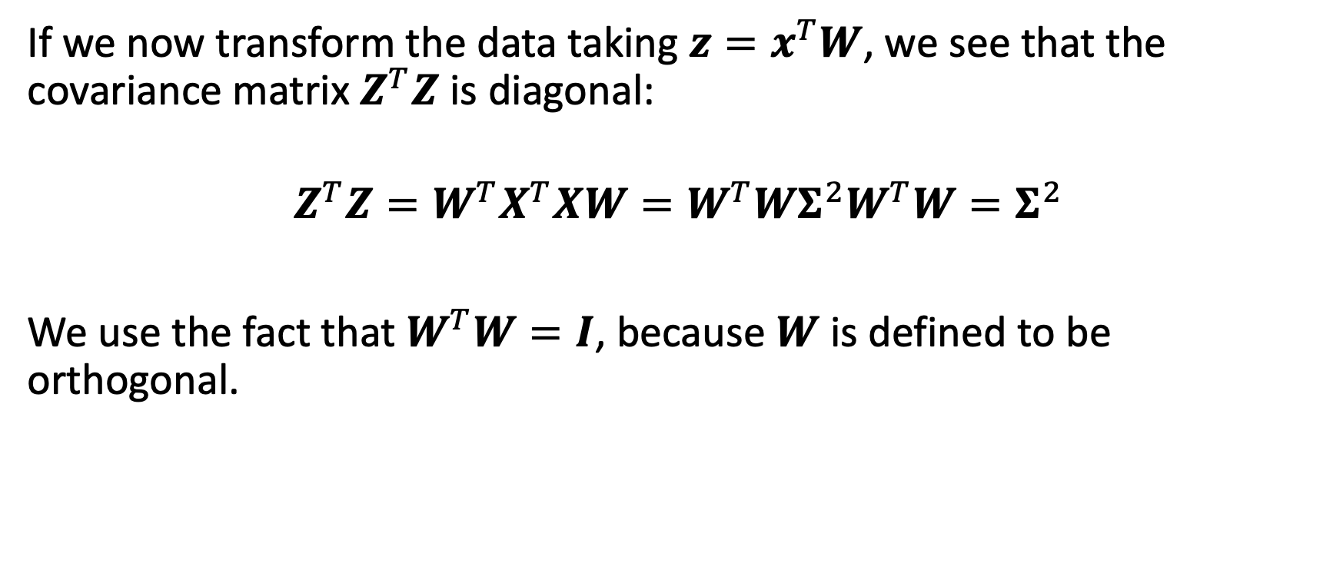
PCA decorrelates features
If we now transform the data taking $z=x^{T}W$, we see that the covariance matrix $Z^{T}Z$ is diagonal:
$$Z^{T}Z=W^{T}X^{T}XW=W^{T}WΣ^{2}W^{T}W=Σ^{2}$$
We use the fact that $W^{T}W=I$, because $W$ is defined to be orthogonal.

Slide 44
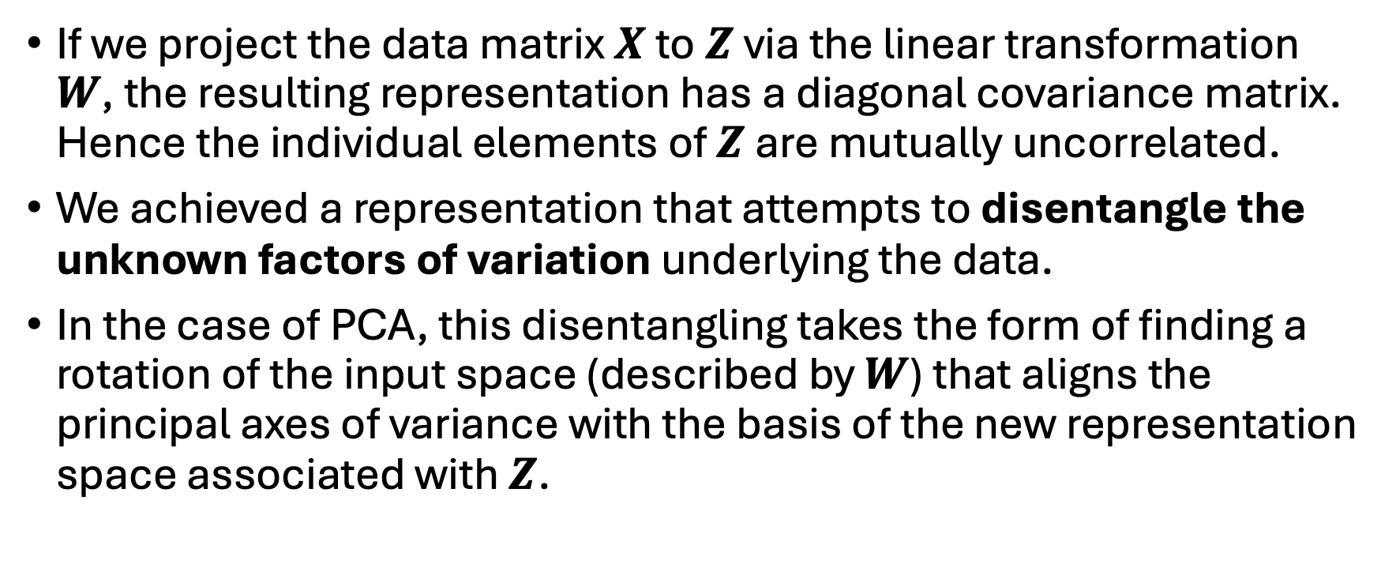
PCA decorrelates features
If we project the data matrix $X$ to $Z$ via the linear transformation $W$, the resulting representation has a diagonal covariance matrix. Hence the individual elements of $Z$ are mutually uncorrelated.
We achieved a representation that attempts to disentangle the unknown factors of variation underlying the data.
In the case of PCA, this disentangling takes the form of finding a rotation of the input space (described by $W$) that aligns the principal axes of variance with the basis of the new representation space associated with $Z$.

Slide 45
Unsupervised learning notebook
Notebook ‘population-clustering’
Data preprocessing
PCA step by step

Slide 46
Supervised Learning
Unveiling the Mentorship of Data

Slide 47
Supervised learning examples
Supervised learning
↳ Classification
↳ Naïve Bayes classifier
Supervised learning
↳ Classification
↳ Decision trees

Slide 48
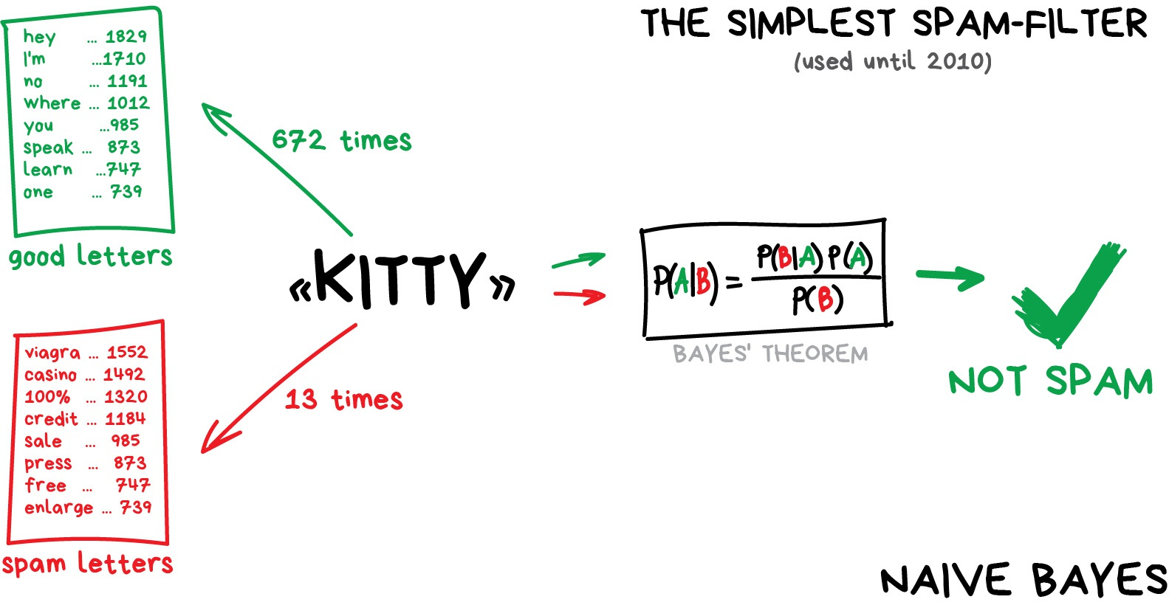
Naïve Bayes classifier
vas3k, 2023

Slide 49
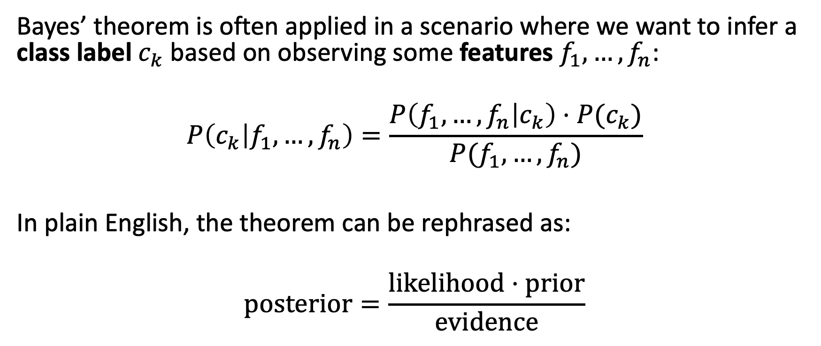
Naïve Bayes classifier
Bayes’ theorem is often applied in a scenario where we want to infer a class label $c_{k}$ based on observing some features $f_{1},…,f_{n}$:
$$P\left(c_{k} | f_{1},…,f_{n}\right)=\frac{P\left(f_{1},…,f_{n} | c_{k}\right)⋅P(c_{k})}{P(f_{1},…,f_{n})}$$
In plain English, the theorem can be rephrased as:
$$\text{p}\text{osterior}=\frac{\text{likelihood}⋅\text{prior}}{\text{evidence}}$$

Slide 50
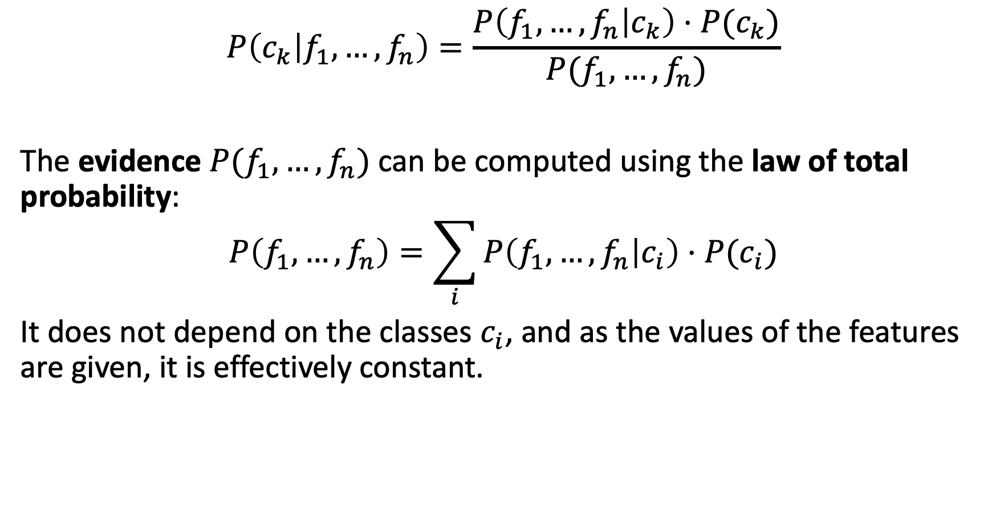
Naïve Bayes classifier
$$P\left(c_{k} | f_{1},…,f_{n}\right)=\frac{P\left(f_{1},…,f_{n} | c_{k}\right)⋅P(c_{k})}{P(f_{1},…,f_{n})}$$
The evidence $P(f_{1},…,f_{n})$ can be computed using the law of total probability:
$$P\left(f_{1},…,f_{n}\right)=\sum_{i}{P\left(f_{1},…,f_{n} | c_{i}\right)⋅P(c_{i})}$$
It does not depend on the classes $c_{i}$, and as the values of the features are given, it is effectively constant.

Slide 51
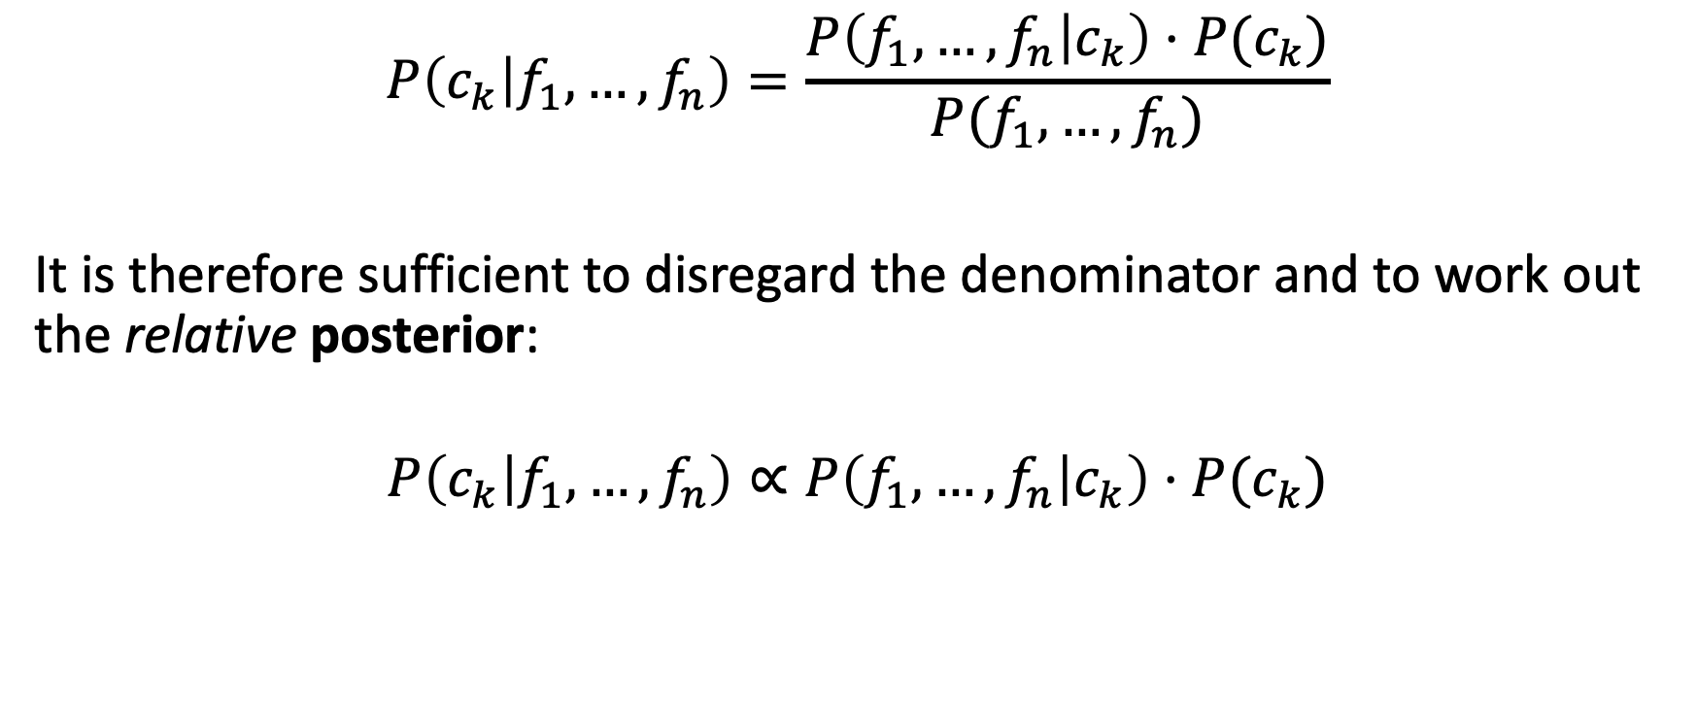
Naïve Bayes classifier
$$P\left(c_{k} | f_{1},…,f_{n}\right)=\frac{P\left(f_{1},…,f_{n} | c_{k}\right)⋅P(c_{k})}{P(f_{1},…,f_{n})}$$
It is therefore sufficient to disregard the denominator and to work out the relative posterior:
$$P\left(c_{k} | f_{1},…,f_{n}\right)∝P\left(f_{1},…,f_{n} | c_{k}\right)⋅P(c_{k})$$

Slide 52
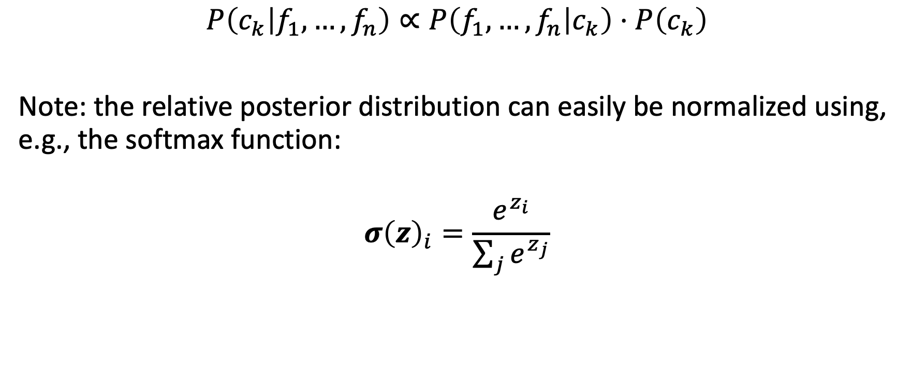
Naïve Bayes classifier
$$P\left(c_{k} | f_{1},…,f_{n}\right)∝P\left(f_{1},…,f_{n} | c_{k}\right)⋅P\left(c_{k}\right)$$
Note: the relative posterior distribution can easily be normalized using, e.g., the softmax function:
$$σ{\left(z\right)}_{i}=\frac{e^{z_{i}}}{\sum_{j}{e^{z_{j}}}}$$

Slide 53
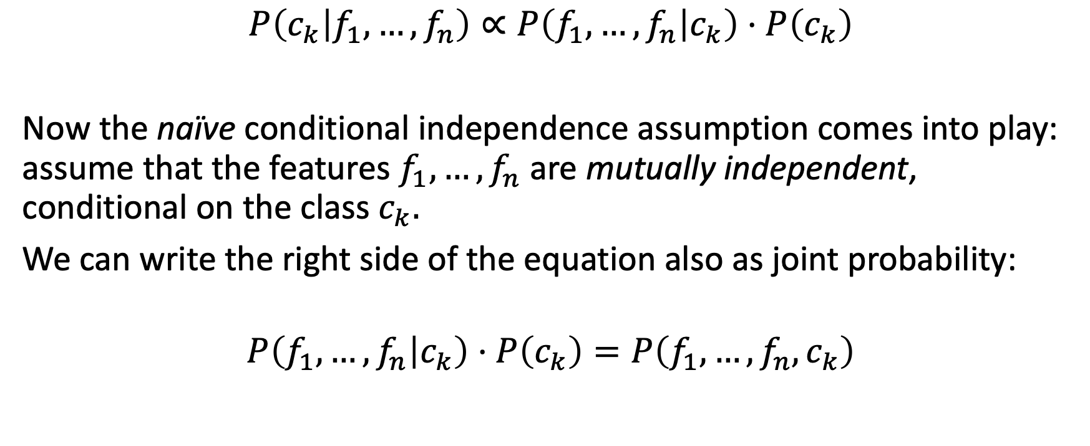
Naïve Bayes classifier
$$P\left(c_{k} | f_{1},…,f_{n}\right)∝P\left(f_{1},…,f_{n} | c_{k}\right)⋅P\left(c_{k}\right)$$
Now the naïve conditional independence assumption comes into play: assume that the features $f_{1},…,f_{n}$ are mutually independent, conditional on the class $c_{k}.$
We can write the right side of the equation also as joint probability:
$$P\left(f_{1},…,f_{n} | c_{k}\right)⋅P\left(c_{k}\right)=P\left(f_{1},…,f_{n},c_{k}\right)$$

Slide 54
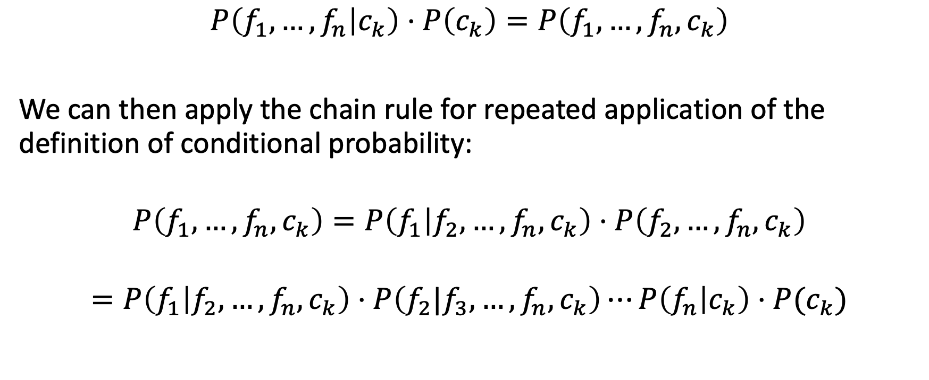
Naïve Bayes classifier
$$P\left(f_{1},…,f_{n} | c_{k}\right)⋅P\left(c_{k}\right)=P\left(f_{1},…,f_{n},c_{k}\right)$$
We can then apply the chain rule for repeated application of the definition of conditional probability:
$$P\left(f_{1},…,f_{n},c_{k}\right)=P\left(f_{1} | f_{2},…,f_{n},c_{k}\right)⋅P\left(f_{2},…,f_{n},c_{k}\right)$$
$$=P\left(f_{1} | f_{2},…,f_{n},c_{k}\right)⋅P\left(f_{2}|f_{3},…,f_{n},c_{k}\right)⋯P\left(f_{n} | c_{k}\right)⋅P(c_{k})$$

Slide 55
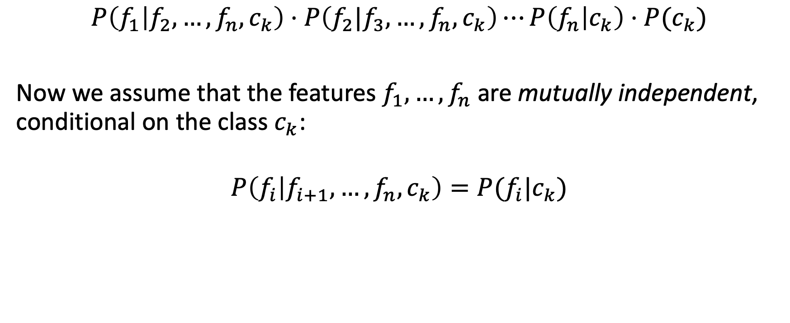
Naïve Bayes classifier
$$P\left(f_{1} | f_{2},…,f_{n},c_{k}\right)⋅P\left(f_{2}|f_{3},…,f_{n},c_{k}\right)⋯P\left(f_{n} | c_{k}\right)⋅P(c_{k})$$
Now we assume that the features $f_{1},…,f_{n}$ are mutually independent, conditional on the class $c_{k}$:
$$P\left(f_{i} | f_{i+1},…,f_{n},c_{k}\right)=P(f_{i}|c_{k})$$

Slide 56
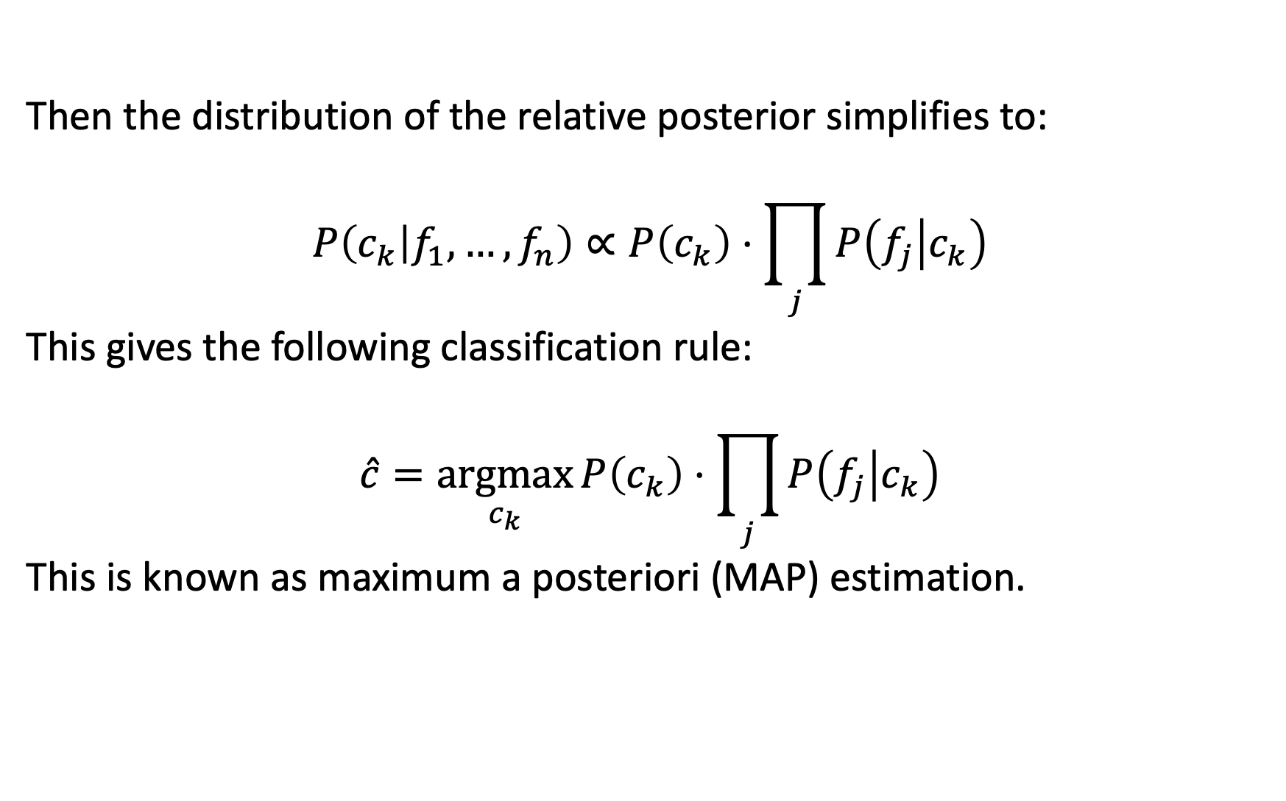
Naïve Bayes classifier
Then the distribution of the relative posterior simplifies to:
$$P\left(c_{k} | f_{1},…,f_{n}\right)∝P\left(c_{k}\right)⋅\prod_{j}{P\left(f_{j} | c_{k}\right)}$$
This gives the following classification rule:
$$\hat{c}=\underset{c_{k}}{argmax}{P\left(c_{k}\right)⋅\prod_{j}{P\left(f_{j} | c_{k}\right)}}$$
This is known as maximum a posteriori (MAP) estimation.

Slide 57
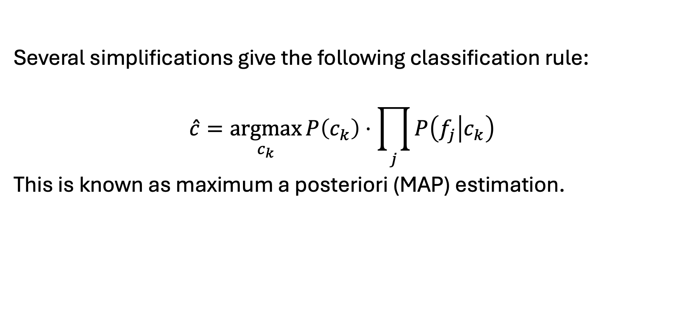
Naïve Bayes classifier
Several simplifications give the following classification rule:
$$\hat{c}=\underset{c_{k}}{argmax}{P\left(c_{k}\right)⋅\prod_{j}{P\left(f_{j} | c_{k}\right)}}$$
This is known as maximum a posteriori (MAP) estimation.

Slide 58
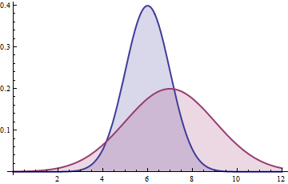
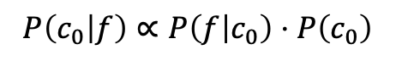

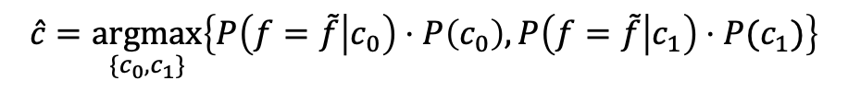
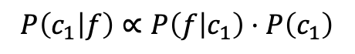
Naïve Bayes classifier
$$P\left(c_{0} | f\right)∝P\left(f | c_{0}\right)⋅P\left(c_{0}\right)$$
The relative class frequencies („priors“) scale the posterior distributions vertically.
$$P\left(c_{1} | f\right)∝P\left(f | c_{1}\right)⋅P\left(c_{1}\right)$$
$$\tilde{f}$$
$$\hat{c}=\underset{\{c_{0},c_{1}\}}{argmax}\left\{P\left(f=\tilde{f} | c_{0}\right)⋅P\left(c_{0}\right),P\left(f=\tilde{f} | c_{1}\right)⋅P(c_{1})\right\}$$

Slide 59
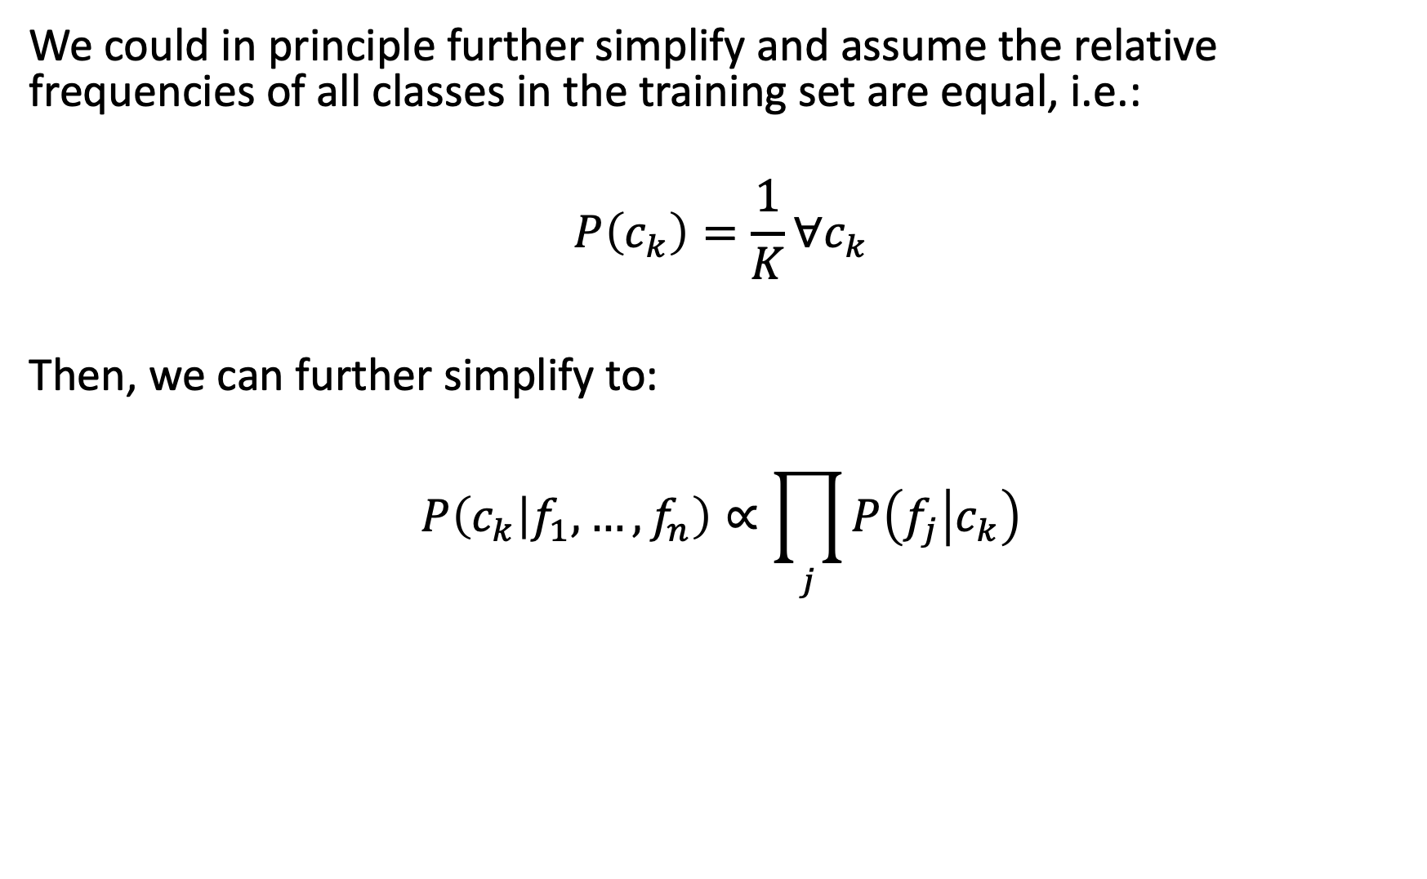
Naïve Bayes classifier
We could in principle further simplify and assume the relative frequencies of all classes in the training set are equal, i.e.:
$$P\left(c_{k}\right)=\frac{1}{K}∀c_{k}$$
Then, we can further simplify to:
$$P\left(c_{k} | f_{1},…,f_{n}\right)∝\prod_{j}{P\left(f_{j} | c_{k}\right)}$$

Slide 60

Naïve Bayes classifier
$$P\left(c_{k} | f_{1},…,f_{n}\right)∝\prod_{j}{P\left(f_{j} | c_{k}\right)}$$
And the following classification rule is known as maximum likelihood (ML) estimation:
$$\hat{c}=\underset{c_{k}}{argmax}{\prod_{j}{P\left(f_{j} | c_{k}\right)}}$$

Slide 61

Naïve Bayes classifier
Maximum a posteriori (MAP) estimation:
$$\hat{c}=\underset{c_{k}}{argmax}{P\left(c_{k}\right)⋅\prod_{j}{P\left(f_{j} | c_{k}\right)}}$$
Maximum likelihood (ML) estimation:
$$\hat{c}=\underset{c_{k}}{argmax}{\prod_{j}{P\left(f_{j} | c_{k}\right)}}$$
Notes:
MAP has the advantage of leveraging information that is brought by the prior and cannot be found in the training data. This additional information helps to reduce the variance in the MAP point estimate (in comparison to the ML estimate).

Slide 62
Supervised learning examples
Supervised learning
↳ Classification
↳ Naïve Bayes classifier
Supervised learning
↳ Classification
↳ Decision trees

Slide 63

A very simple decision tree
vas3k, 2023

Slide 64

A tree of questions
A decision tree is a model composed of a collection of “questions” organized hierarchically in the shape of a tree. The questions are usually called a condition, a split, or a test.

Slide 65

Inference

Slide 66

Axis-aligned conditions

Slide 67

Oblique conditions

Slide 68

Training decision trees
Create a root.
Grow node #1. The condition “x1 ≥ 1” was found. Two child nodes are created.
Grow node #2. No satisfying conditions were found. So, make the node into a leaf.
Grow node #3. The condition “x2 ≥ 0.5” was found. Two child nodes are created.

Slide 69
The splitter
The routine responsible for finding the best condition is called the splitter. Because it needs to test a lot of possible conditions, splitters are the bottleneck when training a decision tree.
The score maximized by the splitter depends on the task. For example:
Information gain and Gini index are commonly used for classification.
Mean squared error is commonly used for regression.
We will look more closely at information gain…

Slide 70

Information gain
The information gain of a random variable $\text{x}$ obtained from an observation of a random variable $\text{a}$ taking value $\text{a}=a$is defined as:
$$IG\left(\text{x},\text{a}=a\right)=H\left(\text{x}\right)−H(\text{x}|\text{a}=a)$$
By learning $\text{a}=a$ about $\text{x}$, our uncertainty about $\text{x}$ can be reduced, i.e.:
$$\text{IG}(\text{x}|\text{a}=a)≥0$$

Slide 71


Information gain
Bad split
Good split

Slide 72
Overfitting & pruning
To limit overfitting a decision tree, apply one or both of the following regularization criteria while training the decision tree:
Set a maximum depth: prevent decision trees from growing past a maximum depth, such as 10.
Set a minimum number of examples in leaf: a leaf with less than a certain number of examples will not be considered for splitting.

Slide 73
Neural Network Fundamentals & Design
Basics, Architectures, Loss, and More

Slide 74
What we will cover
Deep learning basics
Defining a neural network architecture
Defining a loss function
Optimizing the loss function

Slide 75

Machine learning framework
ML framework = data-driven learning of a mapping from in- to output
“Traditional” ML approaches:
Feature extractor
Machine learning model
Input
Output
(e.g., )
(e.g., color and texture)
(e.g., decision tree)
(e.g., benign or malignant)

Slide 76
Machine learning framework
“Traditional” ML approaches:
Deep learning:
Feature extractor
Machine learning model
Input
Output
(e.g., )
(e.g., color and texture)
(e.g., decision tree)
(e.g., benign or malignant)
Directly learns what are useful (and better) features from the training data
Input
Deep learning model
Output
(e.g., )
(e.g., convolutional neural network)
(e.g., benign or malignant)

Slide 77
Defining a neural network architecture
Our first architecture: a single-layer, fully connected neural network
Fully connected = all inputs of a layer are connected to all outputs of a layer
For simplicity, we will use a 3-dimensional input

Slide 78










Defining a neural network architecture
Layer inputs
Output: $\hat{y}=w_{1}x_{1}+w_{2}x_{2}+w_{3}x_{3}+b=w^{T}x+b$
Neural network parameters: $W=\left\{w, b\right\}$
Caveats:
Single layer still “shallow”, not yet a “deep” neural network
Equivalent to a linear regression model (but a useful base case)
Layer output(s)
$$x_{1}$$
$$w_{1}$$
Often refer to all parameters together as just “weights”. Bias is implicitly assumed.
$$w_{2}$$
Layer bias
$$x_{2}$$
$$Σ$$
$$\hat{y}$$
$$w_{3}$$
Layer weights
$$x_{3}$$
Bias term (allows constant shift)
$$b$$

Slide 79










Defining a loss function
Output: $\hat{y}=w_{1}x_{1}+w_{2}x_{2}+w_{3}x_{3}+b=w^{T}x+b$
Neural network parameters: $W=\left\{w, b\right\}$
Loss functions are quantitative measures of how satisfactory the model predictions are (i.e., how “good” the model parameters are).
Here, we will use the mean squared error (MSE) loss, targeting a regression use case.
$$x_{1}$$
$$w_{1}$$
$$w_{2}$$
$$x_{2}$$
$$Σ$$
$$\hat{y}$$
$$w_{3}$$
$$x_{3}$$
$$b$$

Slide 80

Defining a loss function
Output: $\hat{y}=w_{1}x_{1}+w_{2}x_{2}+w_{3}x_{3}+b=w^{T}x+b$
Neural network parameters: $W=\left\{w, b\right\}$
MSE loss for a single example $x^{(i)}$ when the prediction is ${\hat{y}}^{(i)}$ and the correct (ground truth) output is $y^{(i)}$:
$$L^{\left(i\right)}\left(W\right)={\left({\hat{y}}^{\left(i\right)}−y^{\left(i\right)}\right)}^{2}$$
MSE loss over a set of examples $i=\left\{1,…,M\right\}$:
$$L=\frac{1}{M}\sum_{i}{L^{\left(i\right)}\left(W\right)}$$
$$x_{1}$$
$$w_{1}$$
$$w_{2}$$
$$x_{2}$$
$$Σ$$
$$\hat{y}$$
$$w_{3}$$
$$x_{3}$$
$$b$$
The loss is small when the prediction is close to the ground truth.

Slide 81





Optimizing the loss function: gradient descent
Goal: find the “best” values of the neural network (i.e., model) parameters that minimize the loss function.
Main idea: to iteratively update the model parameters, take steps in the local direction of steepest (negative) slope, i.e., the negative gradient
“Loss landscape”: the value of the loss function at every values of the model parameters
$$L$$
$$w_{2}$$
$$w_{1}$$
$w_{3}$ omitted here

Slide 82

Review: derivatives and gradients
The derivative of a function is a measure of local slope.
Example: $f\left(x\right)=x^{2} \frac{∂f}{∂x}=2x$
The gradient of a function of multiple variables is the vector of partial derivatives of the function w.r.t. each variable.
Example: $f\left(x_{1},x_{2}\right)=3x_{1}^{2}+x_{2}^{2} ∇f= \left[\begin{matrix}\frac{∂f}{∂x_{1}} \\ \frac{∂f}{∂x_{2}}\end{matrix}\right]={\left[\begin{matrix}6x_{1} & 2x_{2}\end{matrix}\right]}^{T}$

Slide 83

Review: derivatives and gradients
$$f\left(x_{1},x_{2}\right)=3x_{1}^{2}+x_{2}^{2} ∇f= \left[\begin{matrix}\frac{∂f}{∂x_{1}} \\ \frac{∂f}{∂x_{2}}\end{matrix}\right]={\left[\begin{matrix}6x_{1} & 2x_{2}\end{matrix}\right]}^{T}$$
The gradient evaluated at a particular point is the directions of steepest ascent of the function at that point:
$${∇f|}_{x_{1}=1,x_{2}=1}={\left[\begin{matrix}6 & 2\end{matrix}\right]}^{T}$$

Slide 84


Gradient descent algorithm
Let the gradient of the loss function w.r.t. the model parameters $w$ be:
$$∇L={\left[\frac{∂L}{∂w_{1}},\frac{∂L}{∂w_{2}},…,\frac{∂L}{∂w_{K}}\right]}^{T}$$
For ease of notation, we rewrite the bias parameter $b$ as a $w_{k}$ (corresponding to a $x_{k}=1$).

Slide 85

Gradient descent algorithm
Then we can minimize the loss function by iteratively updating the model parameters (“taking steps”) in the direction of the negative gradient, until convergence:
$$w≔w−η∇L$$
“Step size” hyperparameter (design choice, also referred to as learning rate), indicating how big of a step in the negative gradient direction we want to take at each update. Too big: may overshoot minima. Too small: optimization takes (too) long.

Slide 86
Gradient descent algorithm
Evaluating the gradient involves iterating over all data examples, which can be slow!
In practice, we usually use stochastic gradient descent (or more sophisticated methods), where we estimate the gradient over a sample of data examples.

Slide 87

Optimizing the loss function: our example
Output: $\hat{y}=w_{1}x_{1}+w_{2}x_{2}+w_{3}x_{3}+b=w^{T}x+b$
Neural network parameters: $W=\left\{w, b\right\}\hat{=}w$
Loss function
Per example $x^{(i)}$: $L^{\left(i\right)}\left(w\right)={\left({\hat{y}}^{\left(i\right)}−y^{\left(i\right)}\right)}^{2}$
Over $M$ examples: $L=\frac{1}{M}\sum_{i}{L^{\left(i\right)}\left(w\right)}$
Gradient of loss function w.r.t. the weights
Partial derivative w.r.t. the $k$-th weight: $\frac{∂L^{\left(i\right)}}{∂w_{k}}=\frac{∂L^{\left(i\right)}}{∂{\hat{y}}^{\left(i\right)}}\frac{∂{\hat{y}}^{\left(i\right)}}{∂w_{k}}=2⋅\left({\hat{y}}^{\left(i\right)}−y^{\left(i\right)}\right)⋅x_{k}^{(i)}$
Over $M$ examples: $\frac{∂L}{∂w_{k}}=\frac{1}{M}\sum_{i}{\frac{∂L^{\left(i\right)}}{∂w_{k}}}=\frac{1}{M}\sum_{i}{2\left({\hat{y}}^{\left(i\right)}−y^{\left(i\right)}\right)x_{k}^{(i)}}$
$$x_{1}$$
$$w_{1}$$
$$w_{2}$$
$$x_{2}$$
$$Σ$$
$$\hat{y}$$
$$w_{3}$$
$$x_{3}$$
$$b$$

Slide 88











The perceptron
Activation functions add nonlinearity to allow the model to express complex nonlinear functions.
Inputs
Weights
$$i_{1}$$
$$w_{1}$$
Activation function
$$i_{2}$$
$$w_{2}$$
$$Σ$$
$$a(⋅)$$
$$o$$
$$w_{K}$$
Output
$$i_{K}$$
$$b$$
Bias
$$o\left(i\right)=a(w^{T}i+b)$$

Slide 89

Activation functions

Slide 90


Activation functions
Piecewise linear, but nonlinear as a whole
Problem: tiny gradients for large and small $x$ (“vanishing gradient”)
Easily differentiable: $si\text{g}′\left(x\right)=\text{sig}(x) \left(1−\text{sig}\left(x\right)\right)$
Output zero can lead to “dying” neurons.
→ Leaky ReLU
Larger slope around $x=0$
Scaled and shifted sigmoid function: $\tanh\left(x\right)=2⋅\text{sig}\left(2x\right)−1$

Slide 91

Computing gradients with backpropagation
Motivation
Deriving a full expression for multi-layer fully-connected neural networks (i.e., multi-layer perceptrons — MLPs) and other more complex architectures is (too) complex.
Key idea
Don’t mathematically derive entire math expression for e.g., $\frac{∂L}{∂w_{k}}$.
Construct a computational graph.
Then, by writing $\frac{∂L}{∂w_{k}}$ as nested applications of the chain rule, only must derive simple “local” gradients representing relationships between connected nodes of the graph.

Slide 92










Backprop in a two-layer MLP
$$W_{1}$$
$$W_{2}$$
Network output: $\hat{y}=W_{2}\left(σ\left(W_{1}x+b_{1}\right)\right)+b_{2}$
Loss: $L={\left(\hat{y}−y\right)}^{2}$
We only consider a single training example; in the case of a minibatch, the gradients $\frac{∂L}{∂w_{k}}$ are averaged over all examples in the minibatch.
$$x_{1}$$
$$h_{1}$$
$$x_{2}$$
$$h_{2}$$
$$\hat{y}$$
$$x_{3}$$
$$h_{3}$$

Slide 93











Backprop in a two-layer MLP
$$W_{1}$$
$$W_{2}$$
Network output: $\hat{y}=W_{2}\left(σ\left(W_{1}x+b_{1}\right)\right)+b_{2}$
Loss: $L={\left(\hat{y}−y\right)}^{2}$
We now think of computing the loss function as a staged computation of intermediate variables:
$$x_{1}$$
$$h_{1}$$
$$x_{2}$$
$$h_{2}$$
$$\hat{y}$$
$$x_{3}$$
$$h_{3}$$
$$W_{1}$$
$$W_{2}$$
$$x$$
$$z$$
$$h$$
$$\hat{y}$$
$$L$$
$$b_{1}$$
$$b_{2}$$
$$y$$

Slide 94











Backprop in a two-layer MLP
$$W_{1}$$
$$W_{2}$$
$$x$$
$$z$$
$$h$$
$$\hat{y}$$
$$L$$
$$b_{1}$$
$$b_{2}$$
$$y$$
Network output: $\hat{y}=W_{2}\left(σ\left(W_{1}x+b_{1}\right)\right)+b_{2}$
Loss: $L={\left(\hat{y}−y\right)}^{2}$
Forward pass:
$$z=W_{1}x+b_{1}$$
$$h=σ\left(z\right)$$
$$\hat{y}=W_{2}h+b_{2}$$
$$L={\left(\hat{y}−y\right)}^{2}$$

Slide 95

Backprop in a two-layer MLP
$$W_{1}$$
$$W_{2}$$
$$x$$
$$z$$
$$h$$
$$\hat{y}$$
$$L$$
$$b_{1}$$
$$b_{2}$$
$$y$$
Now, can use a repeated application of the chain rule, going backwards through the computational graph, to obtain the gradient of the loss with respect to each node of the computation graph.
The goal is to obtain all $\frac{∂L}{∂w_{k}}$.
Backward pass:
$$\frac{∂L}{∂\hat{y}}=2\left(\hat{y}−y\right), \frac{∂L}{∂W_{2}}=\frac{∂L}{∂\hat{y}}\frac{∂\hat{y}}{∂W_{2}}, \frac{∂L}{∂h}=\frac{∂L}{∂\hat{y}}\frac{∂\hat{y}}{∂h}, \frac{∂L}{∂z}=\frac{∂L}{∂h}\frac{∂h}{∂z}, \frac{∂L}{∂W_{1}}=\frac{∂L}{∂z}\frac{∂z}{∂W_{1}}$$
Plug in from earlier computations via chain rule
Local gradients to derive

Slide 96

Learning rates
Q: Which one of these learning rates is best to use?
A: All of them! Start with large learning rate and decay over time.
Empirical rule of thumb: If you increase the batch size by N, also scale the initial learning rate by N.

Slide 97
Batch size
Batch size vs. training data:
In a typical ML dataset, you have many training examples, each consisting of input data (features) and corresponding target labels.
Instead of feeding the entire dataset into the neural network at once, you divide it into smaller subsets or batches.
Batch size and training iterations:
During each training iteration (or epoch), the model processes one batch of data. The batch size determines how many examples are included in this batch.
After processing one batch, the model computes the gradient of the loss function with respect to its parameters (weights and biases) using the examples in that batch.
Impact on training:
Smaller batch size: more frequent model parameter updates. Can lead to noisy gradients but can help the model converge faster.
Larger batch size: more stable gradient estimates. May slow down training convergence, especially on large datasets.
Trade-offs:
Training speed vs. model stability.
Also, larger batch sizes can be computationally efficient but might not fit in GPU memory for very large datasets.

Slide 98


Monitor learning curves
Periodically evaluate validation loss
Also, useful to plot performance on final metric

Slide 99
Training, validation, and test set
Training set
Largest subset, typically around 70–80% of the entire dataset
Validation set
Used to fine-tune the model’s hyperparameters (e.g., learning rate, batch size, number of layers) and assess its performance during training
Used to regularly monitor the model’s generalization performance
Typically, around 10–15% of the entire dataset
Test set
Used to assess the final performance of the trained model
Serves as a proxy for how well the model is expected to perform on new, unseen data
Do not use during model development or hyperparameter tuning!

Slide 100



Overfitting vs. underfitting
Training
Validation
Overfitting
Underfitting
Small or no gap between training and validation loss
Training loss much better than validation
Training loss may continue to get better while validation plateaus or gets worse
May have relatively higher loss overall (model not learning sufficiently)
Model is “overfitting” to the training data. Best strategy: increase data or regularize model. Second strategy: decrease model capacity (make simpler).
Model is not able to sufficiently learn to fit the data well. Best strategy: increase complexity (e.g., size) of the model. Second strategy: make problem simpler (easier task, cleaner data).

Slide 101

Over- vs. underfitting — more intuition

Slide 102




Debugging using learning curves
Plateau may be bad weight initialization
Loss decreasing, but slowly. Try higher learning rate.
Healthy loss curve plateaus. Try further learning rate decay at plateau point.
If you decay learning rate too early, may look like this.

Slide 103
Major design choices
Architecture type (FNN, CNN, RNN, autoencoder, …)
Depth (i.e., no. of layers)
For MLPs, no. of neurons in each layer (i.e., hidden layer size)
Many more
If trying to make a network bigger (when underfitting) or smaller (when overfitting), it is recommended to adjust network depth and hidden layer size first. Don’t waste too much time early on fiddling with choices that only minorly change the architecture.

Slide 104


Architecture types
Feedforward neural network (FNN)
Basic neural network where information flows in one direction, from input to output layers
Composed of input, hidden, and output layers
Used for tasks like classification and regression
Convolutional neural network (CNN)
Specialized for processing grid-like data, such as images and video
Employs convolutional layers to automatically learn and extract hierarchical features

Slide 105


Architecture types
Recurrent neural network (RNN)
Designed to handle sequential data, information flows in loops or recurrent connections
Suitable for tasks like natural language processing, speech recognition, and time series prediction
Has a hidden state that maintains memory of previous inputs
See also: LSTM, GRU
Autoencoder
Neural network designed for unsupervised learning and feature extraction
Consists of an encoder to compress data and a decoder to reconstruct it
Used in dimensionality reduction, denoising, and anomaly detection
Many more…

Slide 106

Regularization
Remember optimizing loss function, which express how well a model fits the training data, e.g.:
$$L=\frac{1}{M}\sum_{i}{{\left({\hat{y}}^{\left(i\right)}−y^{\left(i\right)}\right)}^{2}}$$
Regularization adds a term to this, to express preferences on the weights (that prevent the model from fitting too well to the training data):
$$L=\frac{1}{M}\sum_{i}{{\left({\hat{y}}^{\left(i\right)}−y^{\left(i\right)}\right)}^{2}}+λR(W)$$
Regularization loss
Data loss
Importance of regularization term (a new hyperparameter)

Slide 107

Regularization
L1 regularization
$$R_{L1}\left(W\right)=\sum_{k}{\left|w_{k}\right|}$$
Encourages the model to reduce the magnitude of some weights to exactly zero, effectively performing feature selection. L1 regularization is useful when you suspect that only a subset of the input features is relevant for the task, as it can lead to sparse weight vectors.
L2 regularization
$$R_{L2}\left(W\right)=\sum_{k}{w_{k}^{2}}$$
Encourages the model to have smaller weight values across all features. L2 regularization helps to prevent extreme weight values and smoothens the optimization landscape, making it easier to train and reducing the risk of overfitting.
Elastic Net regularization
$$R_{EN}(W)=α⋅R_{L1}\left(W\right)+\left(1−α\right)⋅R_{L2}(W)$$
Combines both L1 and L2 regularization by adding a penalty term that is a linear combination of the L1 and L2 penalties. It provides a balance between feature selection (L1) and weight smoothing (L2).

Slide 108
More design choices
Implicit regularization
E.g., dropout: during training, at each iteration of forward pass randomly set some neurons to zero. Prevents the network from relying too heavily on any individual neuron, which encourages a more robust and generalizable model.
E.g., batch normalization: during training, at each iteration of forward pass normalize neuron activations by mean and variance of (mini-)batch. Allows keeping the weights in a healthy range.
Data augmentation: augment effective training data size by simulating more diversity from existing data. Attention: augmentation must be realistic!
Weight initialization
Hyperparameter search

Slide 109
Neural network notebook
Notebook ‘pytorch-tutorial’
Data generation
Linear regression in NumPy
Linear regression with PyTorch
Tensors
Computation of gradients
Optimizer
Loss
Model
Evaluation

